Slide 1
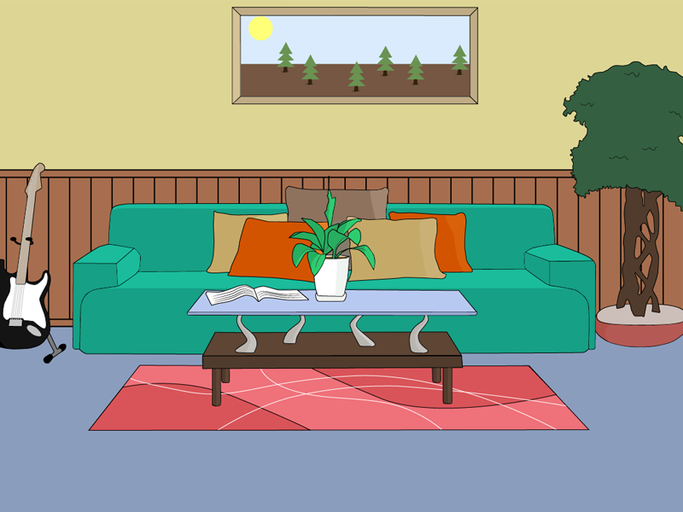

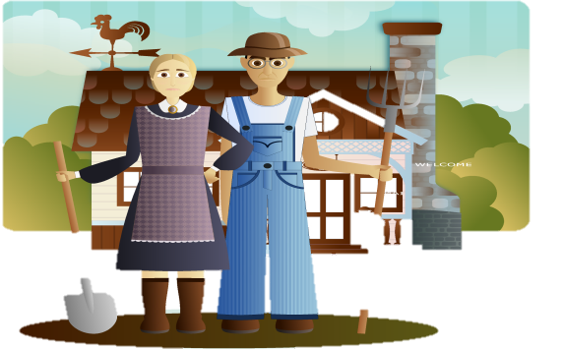
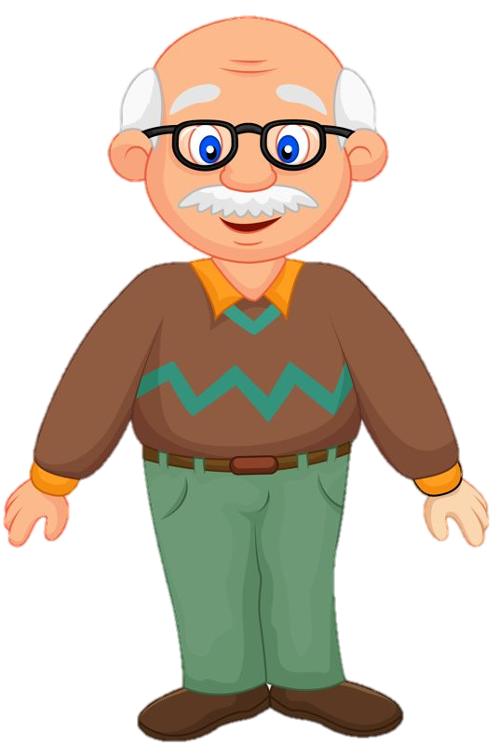


MY GRANDFATHER
Make
a sentence
Find
the photo of my grandfather.
Used to – Present Simple

Slide 2
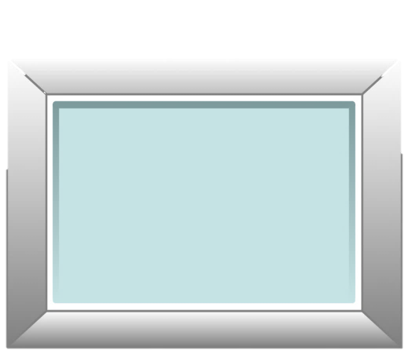
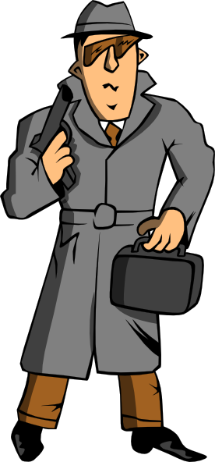

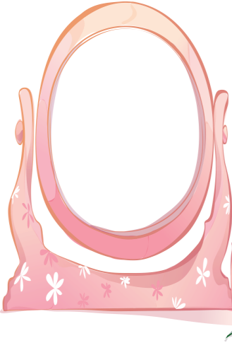


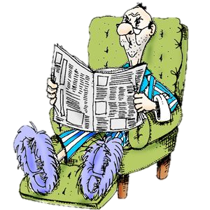

My grandpa
used to be
a sailor.
He used to work in a big ship.
Now he often
sits in the armchair
and reads a newspaper.
Some time ago
be a .....
work in a big ship
Now
Sit and read
Murder in the library

Slide 3
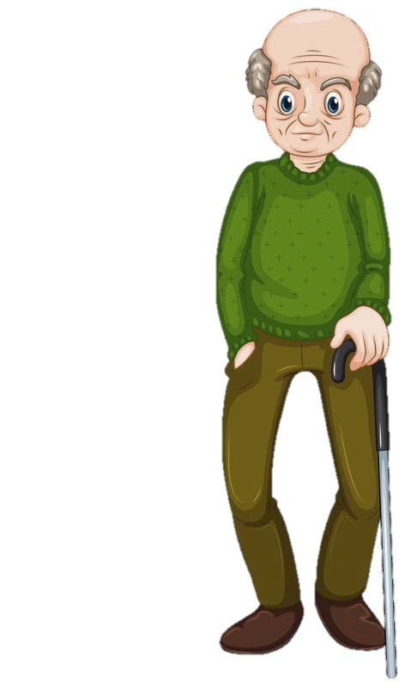
My grandpa
used to be
a policeman.
He used to arrest the criminals.
Now he writes the crime novels.
Some time ago
be a .....
Arrest the criminals
Now
write
Murder in the library

Slide 4
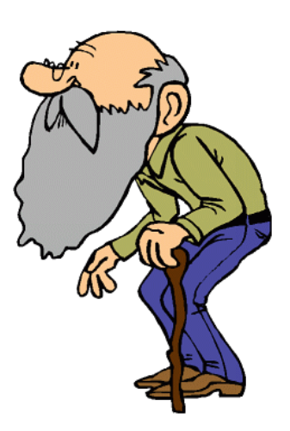
Some time ago
be a .....
work in a secret agency
Now
have
My grandpa
used to be
a spy.
He used to work in a secret agency.
Now he has got a real beard.
Murder in the library

Slide 5
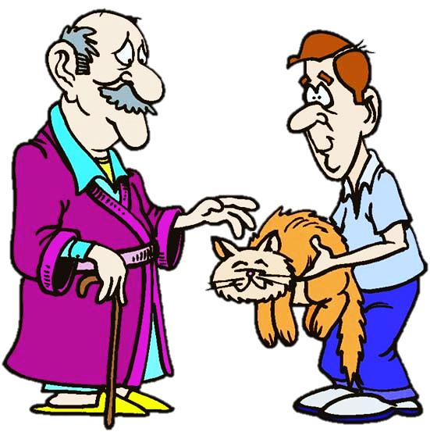
My grandpa
used to be
a politician.
He used to lead a politic party.
Now he looks after the stray animals.
Some time ago
be a .....
Lead a party
Now
look after
Murder in the library

Slide 6
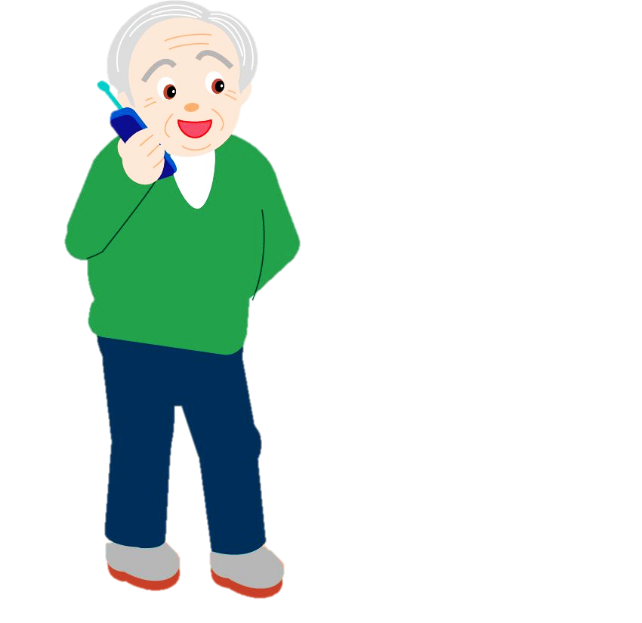
My grandpa
used to be
a farmer.
He used to milk the cows.
Now he often talks on his mobile phone.
Some time ago
be a .....
milk the cows
Now
talk
Murder in the library

Slide 7
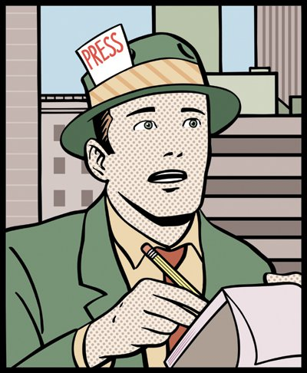

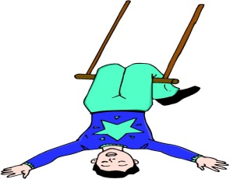
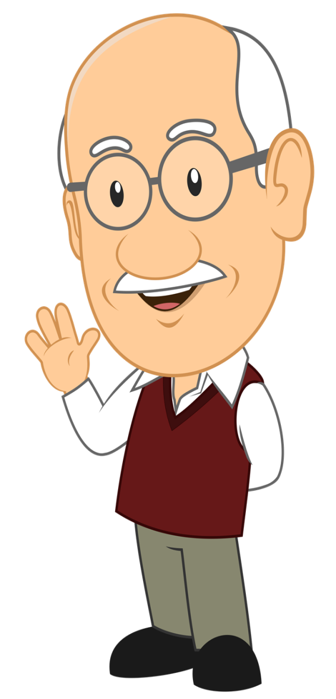
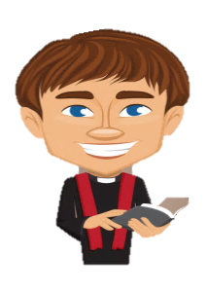
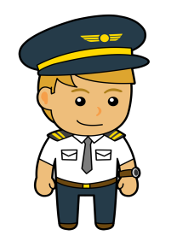

My grandpa
used to be
a pilot.
He used to guide a plane.
Now he makes the model aeroplanes.
Some time ago
be a .....
Guide a plane
Now
make
Murder in the library

Slide 8
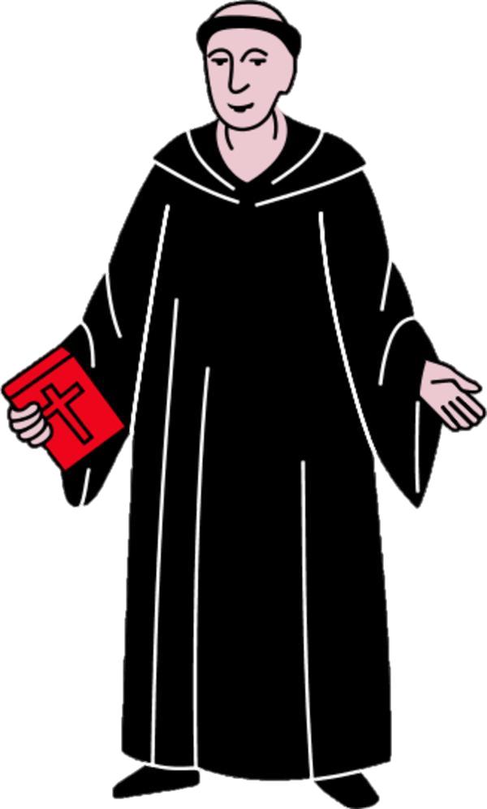
Some time ago
be a .....
Officiate at the church service
Now
be
My grandpa
used to be
a vicar.
He used to offciate at the church service.
Now he is Buddhist.
Murder in the library

Slide 9
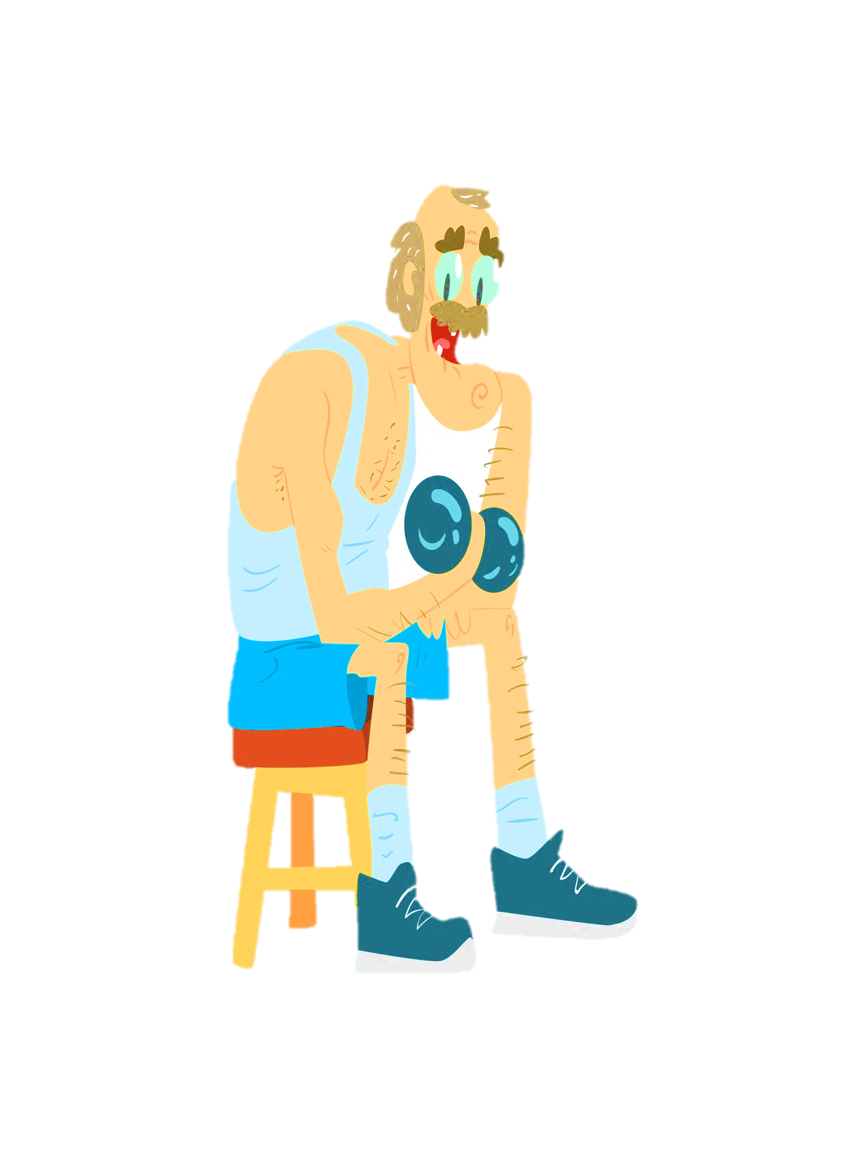
My grandpa
used to be a chemist.
He used to sell medicines.
Now he often exercices at the gym.
Some time ago
be a .....
sell medicines
Now
exercice
Murder in the library

Slide 10
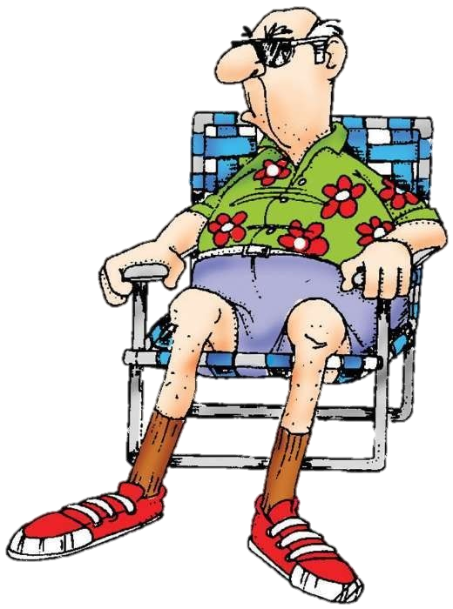
My grandpa
used to be
a journalist
He used to take the interviews .
Now he often relaxes by the beach.
Some time ago
be a .....
take the interviews
Now
relax by the beach
Murder in the library

Slide 11
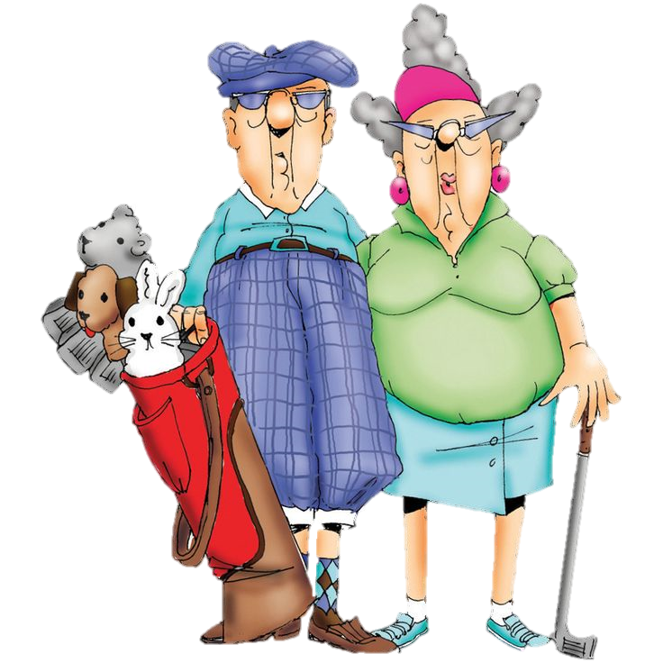
Some time ago
be a .....
Perform tricks on the trapeze
Now
Play
My grandpa
used to be
a trapeze artist.
He used to perform tricks on the trapeze.
Now he often plays golf with his wife.
Murder in the library

