Slide 1
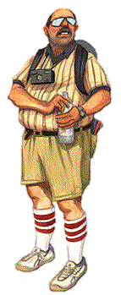
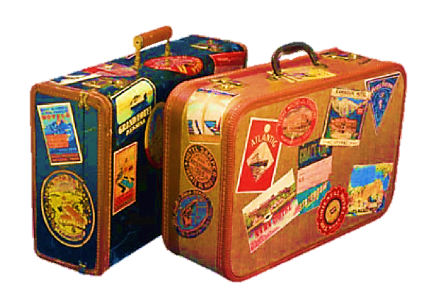
Past simple tense

Slide 2
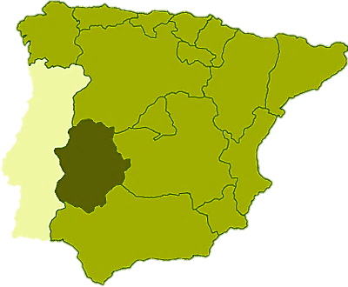
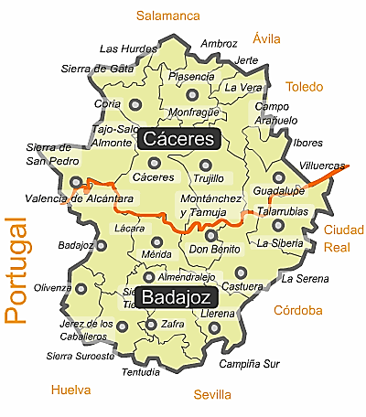
Let us show you some pictures of our last holidays in Extremadura, Spain.
SPAIN
EXTREMADURA

Slide 3
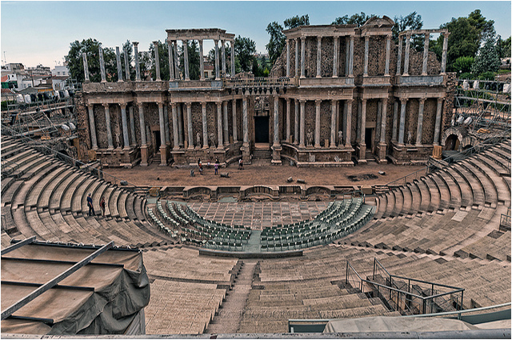
I ________ this photo in Mérida. This is the Roman theatre.
took
Teatro romano de Mérida.
take
took
taken

Slide 4
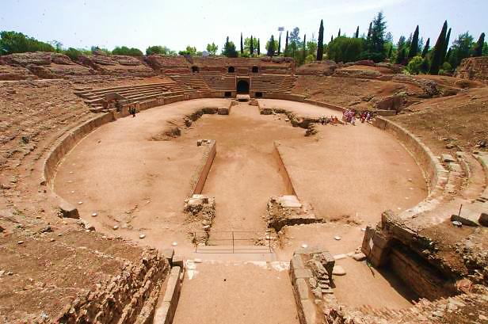
The gladiators ________ in this amphiteather.
fought
Anfiteatro romano. Mérida.
fighting
fought
fight

Slide 5
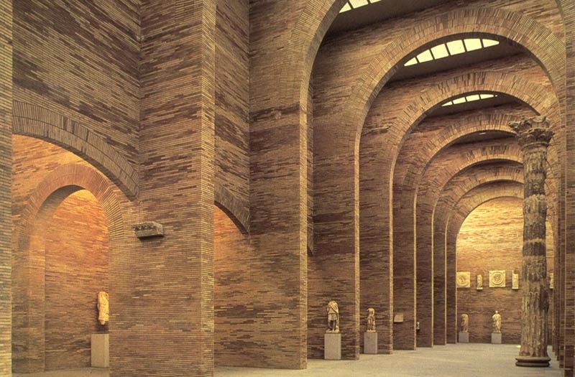
We ________ the National Museum of Roman Art there.
visited
Museo Nacional de Arte Romano. Mérida.
visit
visited
visiting

Slide 6
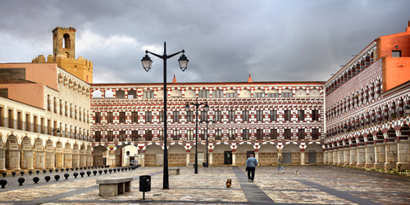
We _______ a relaxing cup of coffee in this square in Badajoz.
drank
Plaza Alta de Badajoz
drank
drink
drunk

Slide 7
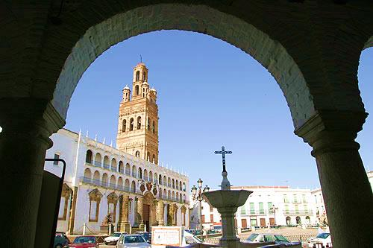
Bells __________ in the tower of this church in Llerena.
chimed
Plaza de Llerena.
chime
chimed
chiming

Slide 8
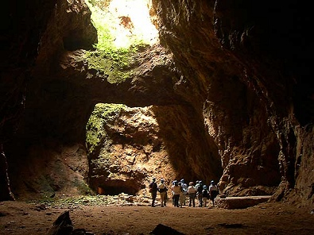
We __________ this old mine near Llerena.
explored
Mina La Jayona.
explore
exploring
explored

Slide 9
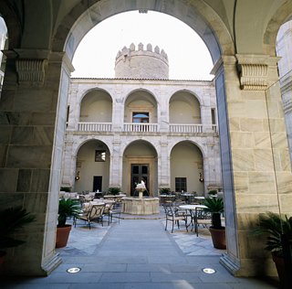
We _______ in this hotel in Zafra.
slept
Parador de Zafra
slept
sleep
sleeping

Slide 10
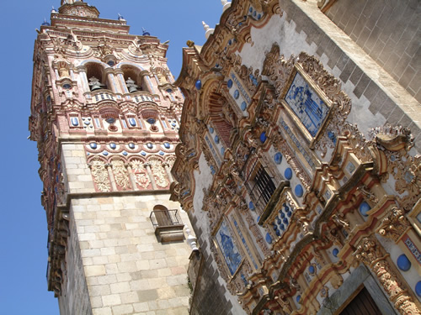
I _______ this church in Jerez de los Caballeros.
loved
Iglesia de San Bartolomé. Jerez de los Caballeros.
love
loving
loved

Slide 11
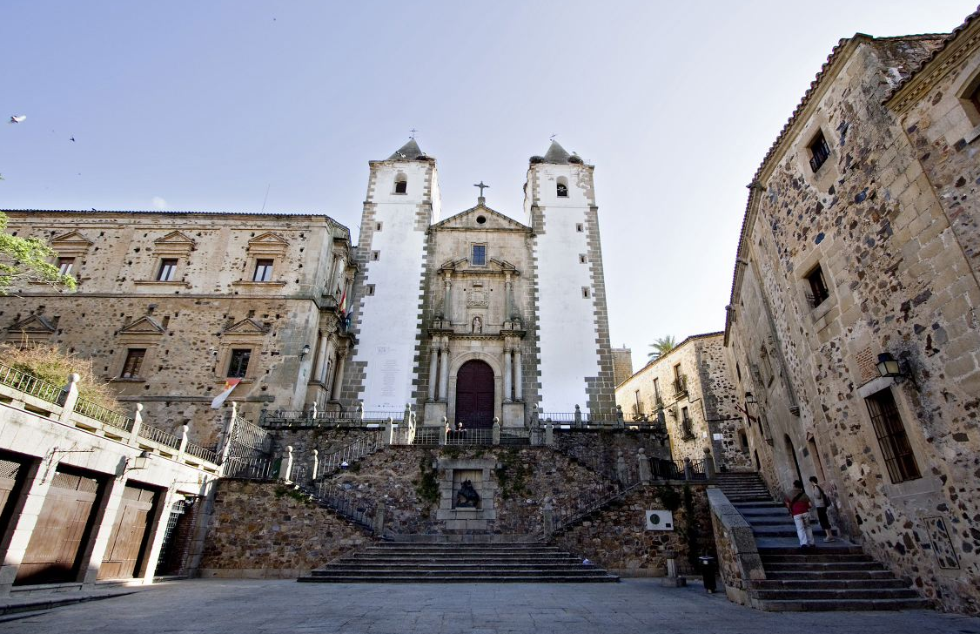
We _________ the streets of the old town in Cáceres.
walked
Plaza de San Jorge. Cáceres.
walked
walk
walking

Slide 12
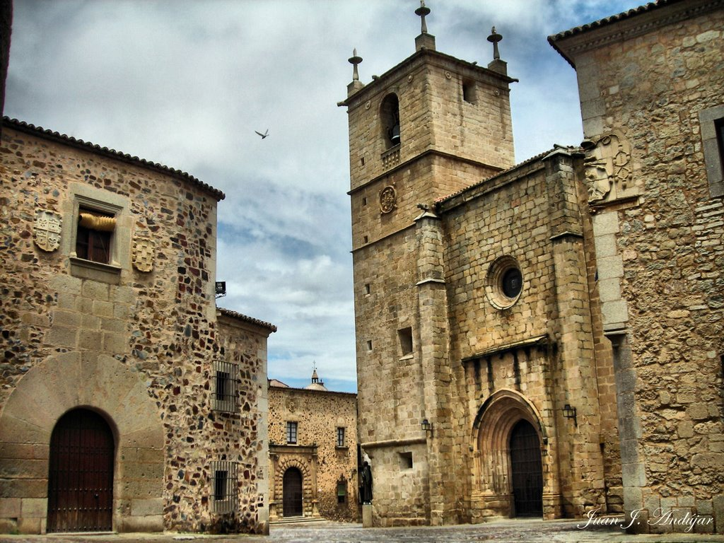
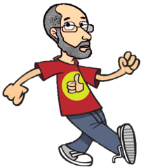
We _________
Mr. Herber there.
met
Plaza de Santa María. Cáceres.
meet
meeting
met

Slide 13
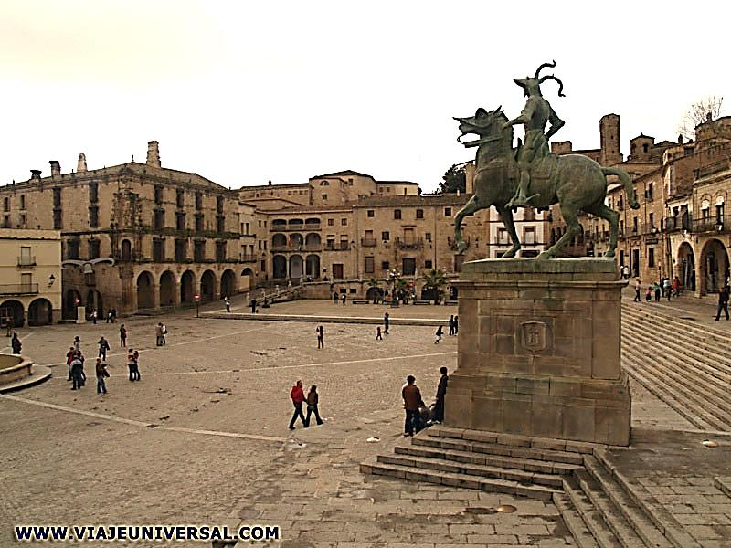
We _________ this scuplture in Trujillo.
saw
Plaza Mayor de Trujillo. Estatua de Francisco Pizarro.
saw
see
seen

Slide 14
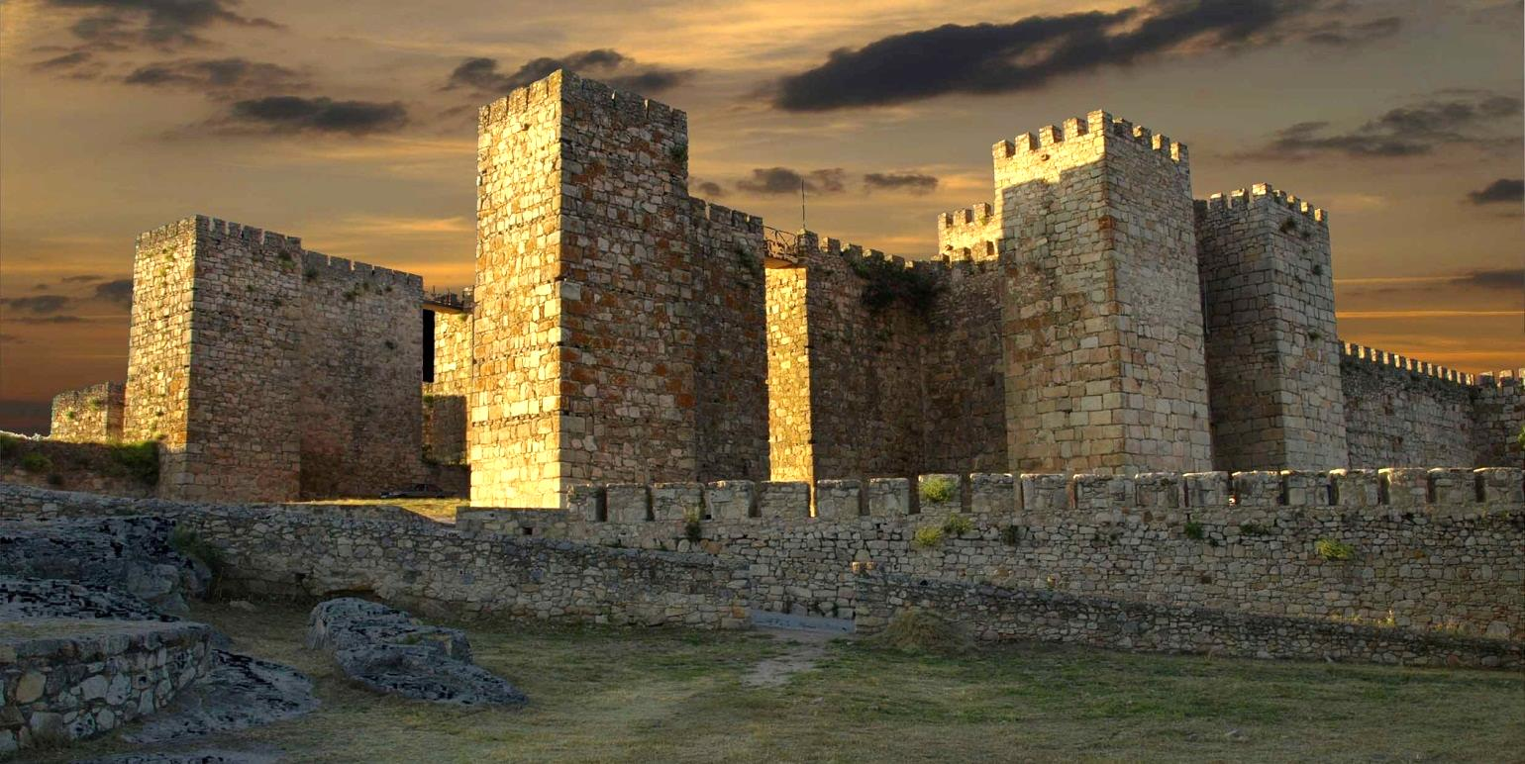
We________ to the castle there.
went
Castillo árabe de Trujillo.
go
went
gone

Slide 15
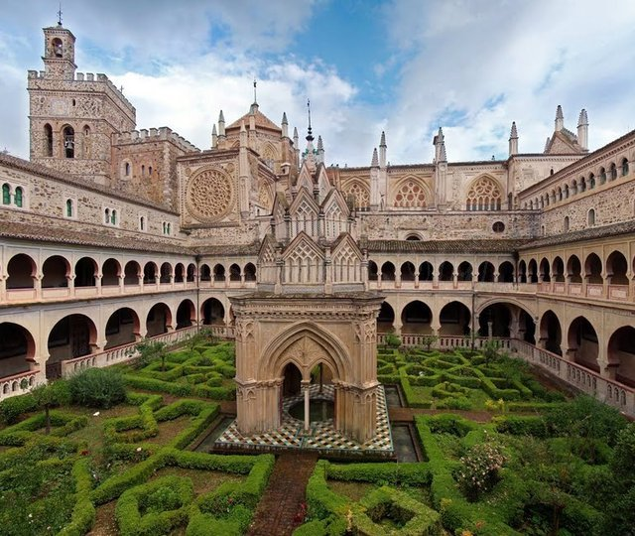
I ________ our car to Guadalupe. This is its famous monastery.
drove
Real Monasterio de Guadalupe.
drive
drove
driven

Slide 16
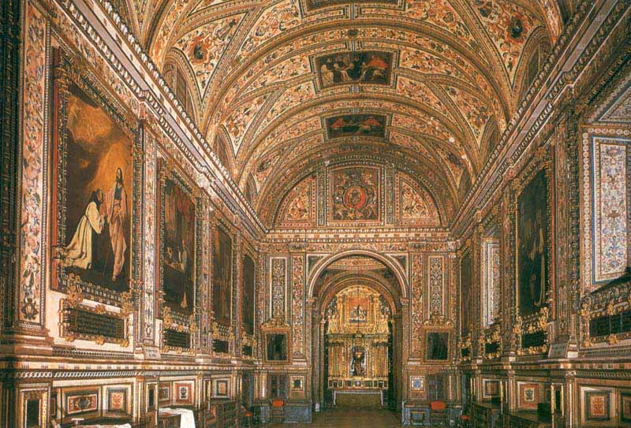
We _________ the paintings in the sacristy.
liked
Monasterio de Guadalupe. Sacristía.
liked
liking
like

Slide 17
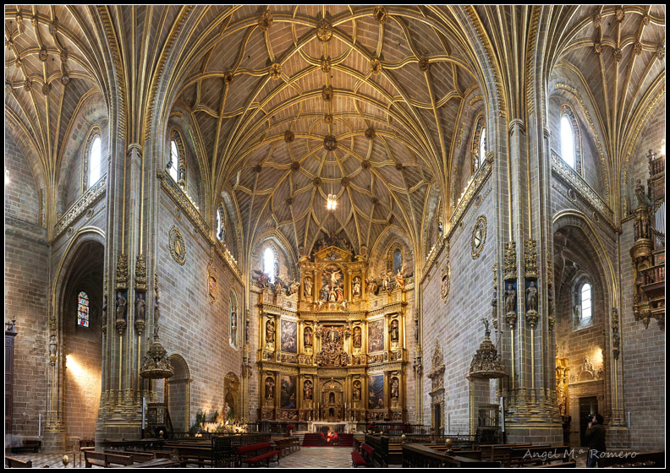
We _________ the visit to the Cathedral of Plasencia.
enjoyed
Catedral de Plasencia
enjoy
enjoyed
enjoying

Slide 18
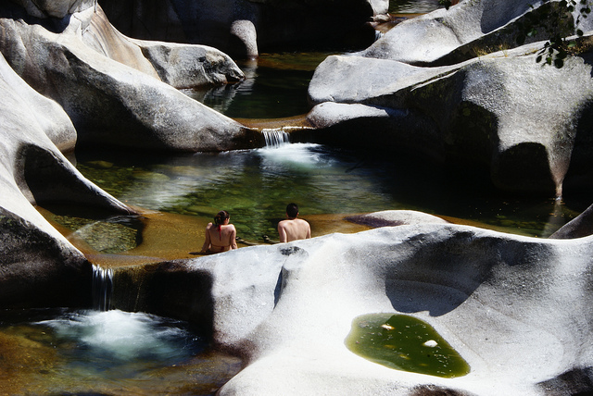
We _________
a bath in this river near there.
had
Garganta de los Infiernos. Valle del Jerte.
have
having
had

Slide 19
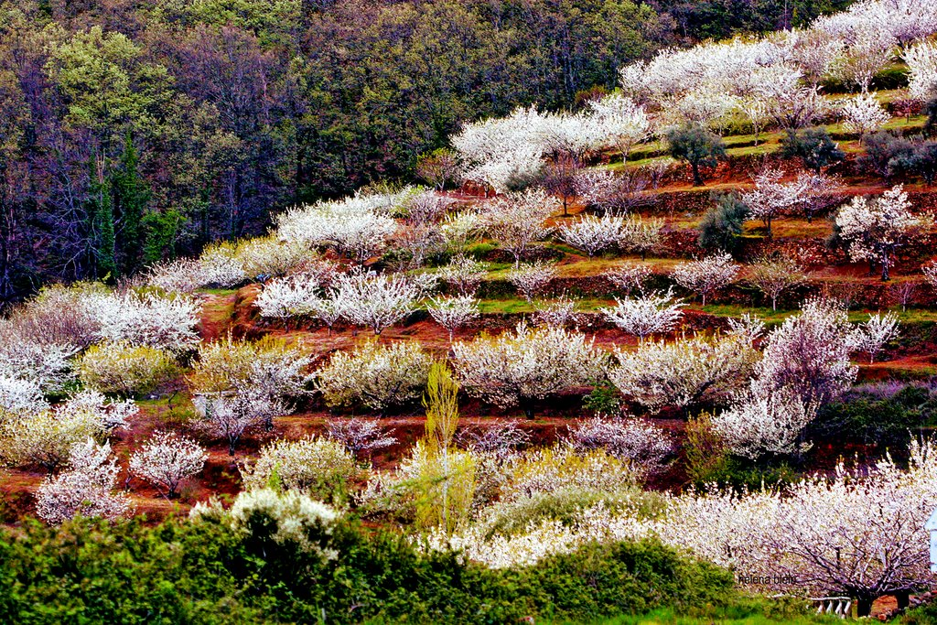
There _______
many beautiful flowers in this valley.
were
Cherry-trees. Valle del Jerte.
been
was
were

Slide 20
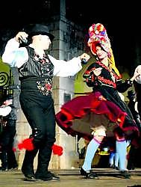
They ________ traditional dances in Montehermoso, a town near Plasencia.
danced
Baile tradicional de Montehermoso
dance
dancing
danced

Slide 21
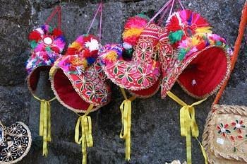
We _________
a traditional hat there.
bought
Sombreros de montehermoseña
buying
bought
buy

Slide 22
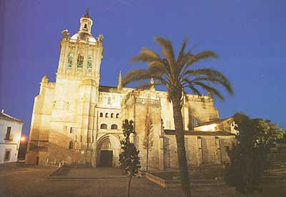
We _______
in Coria in the evening. This is its Cathedral.
arrived
Catedral de Coria.
arrive
arriving
arrived

Slide 23
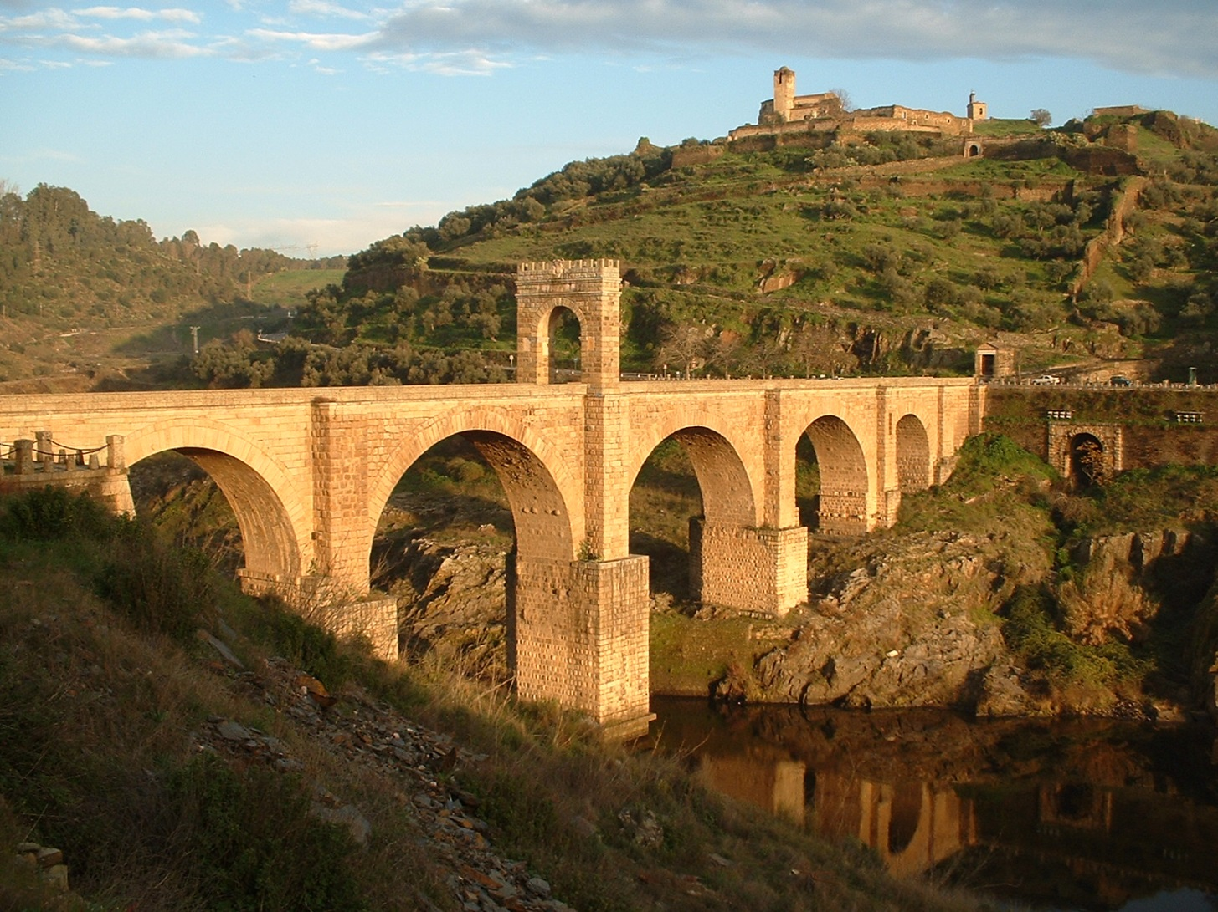
We _________ the Roman bridge of Alcántara.
crossed
Puente romano de Alcántara
cross
crossed
crossing

Slide 24
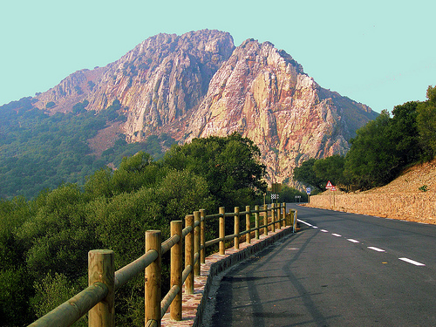
We _________
a lot of birds in this national park.
watched
Parque Nacional de Monfragüe
watch
watched
watching

Slide 25
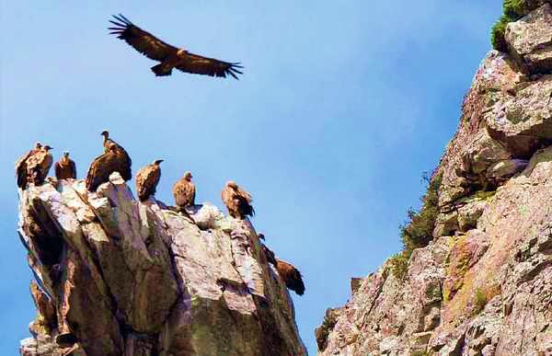
The vultures ________ over our heads.
flew
Parque Nacional de Monfragüe
fly
flew
flown

Slide 26
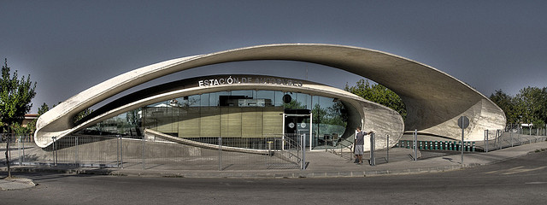
We _________
this futuristic bus station in Casar de Cáceres.
found
Estación de autobuses de Casar de Cáceres
finding
found
find

Slide 27
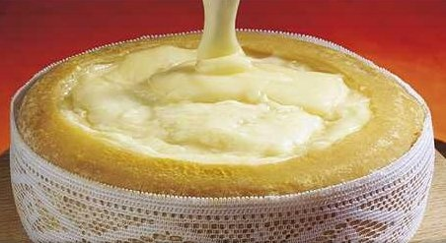
We _________
this delicious cheese there.
ate
Torta del Casar
eat
eaten
ate

Slide 28
We _______
a fantastic experience.
had
having
have
had

