Slide 1
review
gEt yourself ready

Slide 2
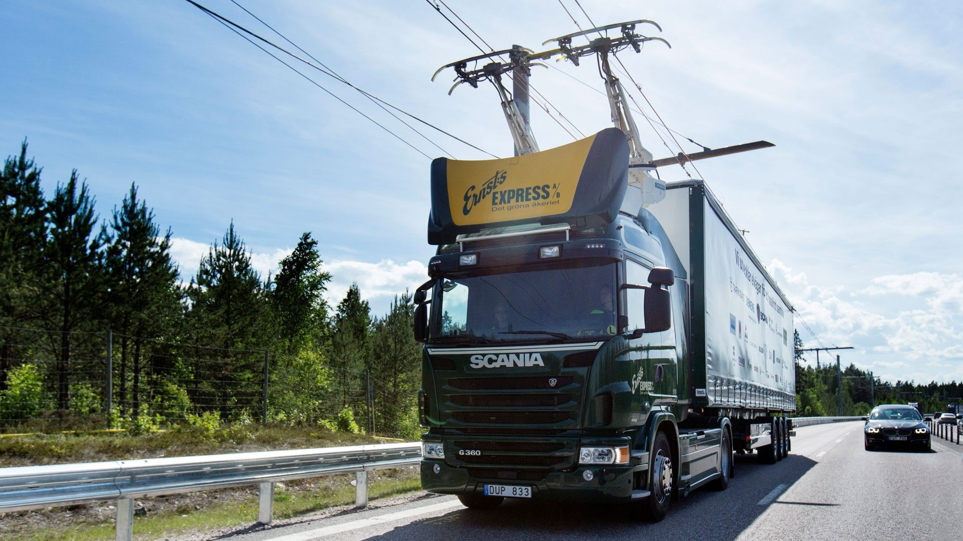
Match them up
What’s unique about this truck?
It uses a hybrid system. / It can be used in e-highhways.
truck
road
overhead electric wires
railroad
roof
It revolutionizes goods transportation system.
4
5
It reduces the use of fossil fuels.
It can eliminate CO2 emissions.
3
Its aim is to better global transactions and manufacturing.
2
It tackles the problem of climate change.
1

Slide 3
A. FILL IN THE BLANKS WITH THE CORRECT WORDS FROM THE LIST.
drain
energies
salaries
responsibilities
citizen
1. Citizens have rights but they must also be aware of their ………………………...
2. Morocco has invested a lot in renewable …………………….
2. An active …………………… is a person who is involved in the improvement of their community.
3. Brain …………………….. occurs when developed countries receive skilled people. One way to deal with this problem is to provide high ………………….………… and good working conditions.

Slide 4
B. FILL IN EACH BLANK WITH THE CORRECT WORD FROM THE LIST.
1. Somebody ……………………. have stolen your phone in the car. Look! The window is still open.
a. will b. must c. can’t
2. You should ………………………… more effort to succeed.
a. have b. do c. make
3. Najib Mahfouz, ………….…… was a famous Egyptian novelist, won the noble prize.
a. where b. whose c. who
4. You have to …………………………the application form and send it to the administration as soon as possible.
a. check in b. fill in c. take off

Slide 5
C. GIVE THE CORRECT FORM OF THE WORDS IN BRACKETS.
Bouchaaib and his wife couldn’t (agreement) ……………...…… on the name of their infant.
Sustainable (develop) …………………..……… should be a priority in political compaigns.
Rachid always relies on his father for (finance) . . . . . . . . . . . . . . . .. support. I don’t think he will ever become (dependent) . . . . . . . . . . . . . . . . . . . .
By joining NGOs, young people can make a positive (contribute) . . . . . . . . . . . . . . . . . . . . to society.
UN officials are concerned about the fast population (grow) . . . . . . . . . . ….. . . in developing countries.
agree
development
financial
independent
contribution
growth

Slide 6
D. REWRITE THE SENTENCES STARTING WITH THE WORDS GIVEN.
1. “I will go to France tomorrow." James said.
James said ……………………………………………...………………
2. Salma didn’t go to the cinema because she didn’t get her parents’ permission.
If Salma had got her parents’ permission, she …………………… ……………… ………………………..
3. We didn't revise our lessons. Now we’ve to sit in for a test.
We wish ……..…………….……………………………………………
he would go to France the following day.
would have gone
to the cinema.
we had revised our lessons.

Slide 7
E. MATCH EACH SENTENCE WITH ITS APPROPRIATE FUNCTION:
1. Ahmed missed the bus because he was late.
2. My condolences.
3. If I were in your shoes, I would continue my higher education.
4. I have no doubt about it.
a. Expressing certainty
b. Cause and effect
c. Apologizing
d. Giving advice
e. Responding to bad news
1. …………….. ; 2. ………….. ; 3. ………….. ; 4. ……………..
b
e
d
a

Slide 9
Report writing
Event: Seminar
Organizers | UNICEF office in Morocco
Topic | Dropping out from school in rural areas; causes and solutions.
Date and place | 02nd March, Municipality conference room.
Objectives | To sensitize parents and civil society about the importance of education. To encourage drop-out to go back to schools.
Participants | About 150 people: teachers, school administrators, politicals, NGOs …
Activities | Morning: 2 presentations, film and discussion. Afternoon: debate + poster exhibitions + prize distribution ceremony.
Conclusion | Opinion and reactions

