Slide 1
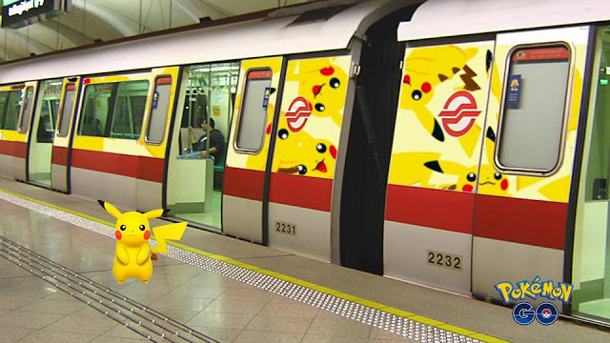
PLACE PREPOSITIONS
WITH POKÉMON GO

Slide 2
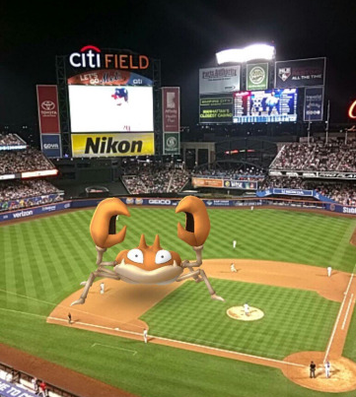
Krabby is ...
the baseball field.
ON

Slide 3
Drowzee is ...
the man’s hand.
IN

Slide 4
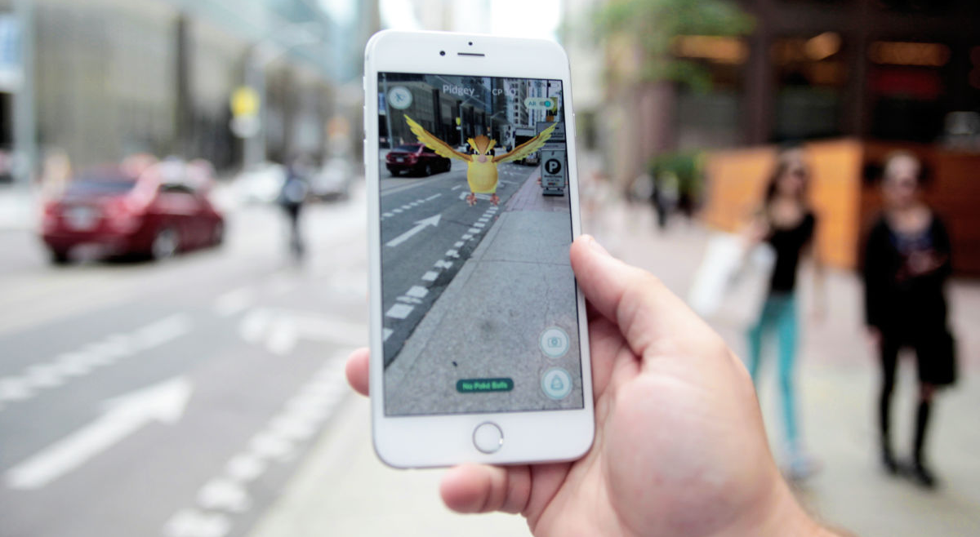
Pidgey is
...
the sidewalk.
ABOVE

Slide 5
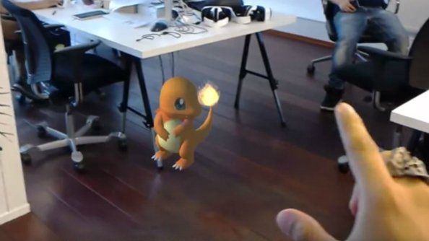
Charmander is ...
the desk.
UNDER

Slide 6
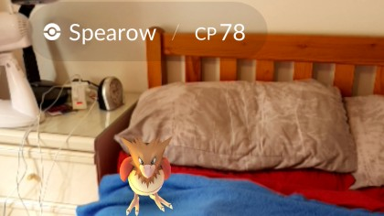
Spearow is
... the bed.
ON

Slide 7
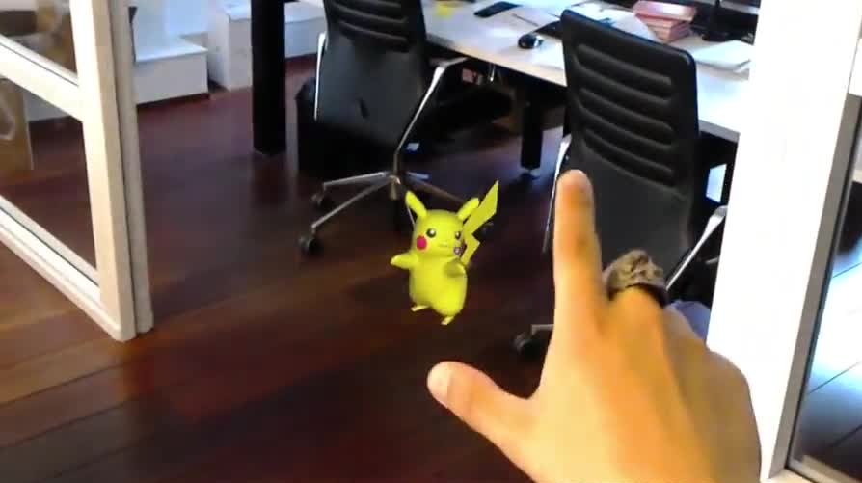
Pikachu
is …
the chairs.
BETWEEN

Slide 8
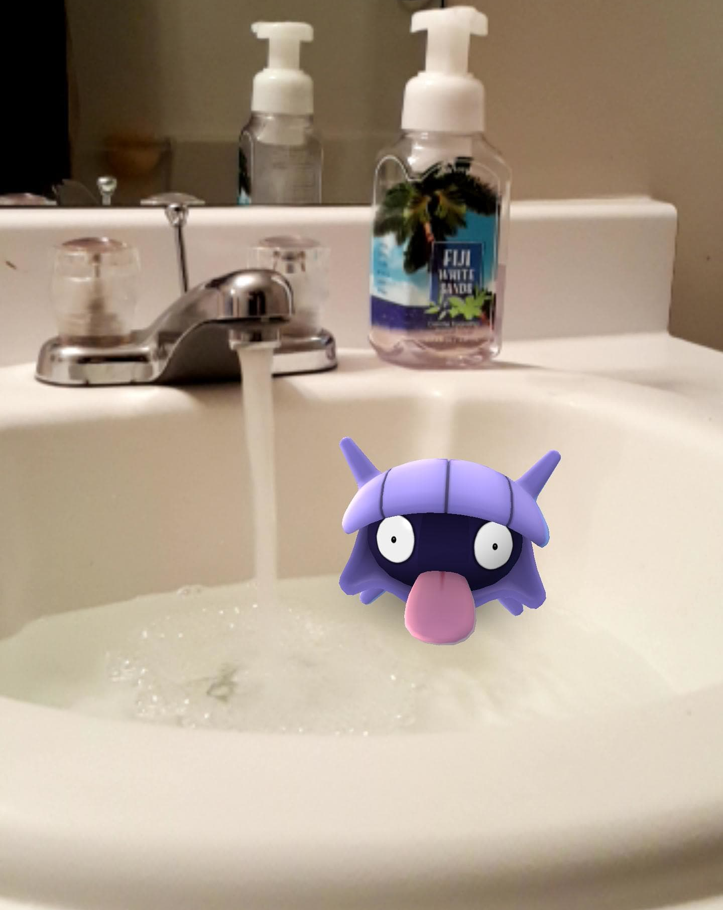
Shellder is
... the sink.
IN

Slide 9
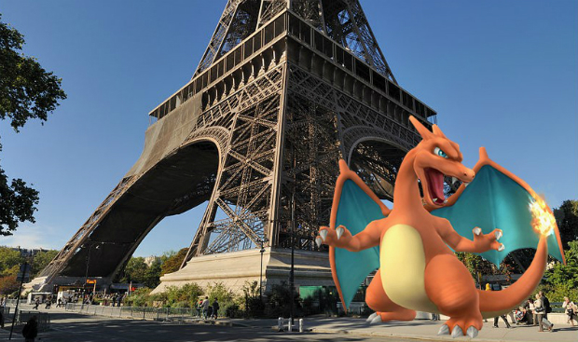
Charizard is …
the Eiffel Tower.
BY

Slide 10
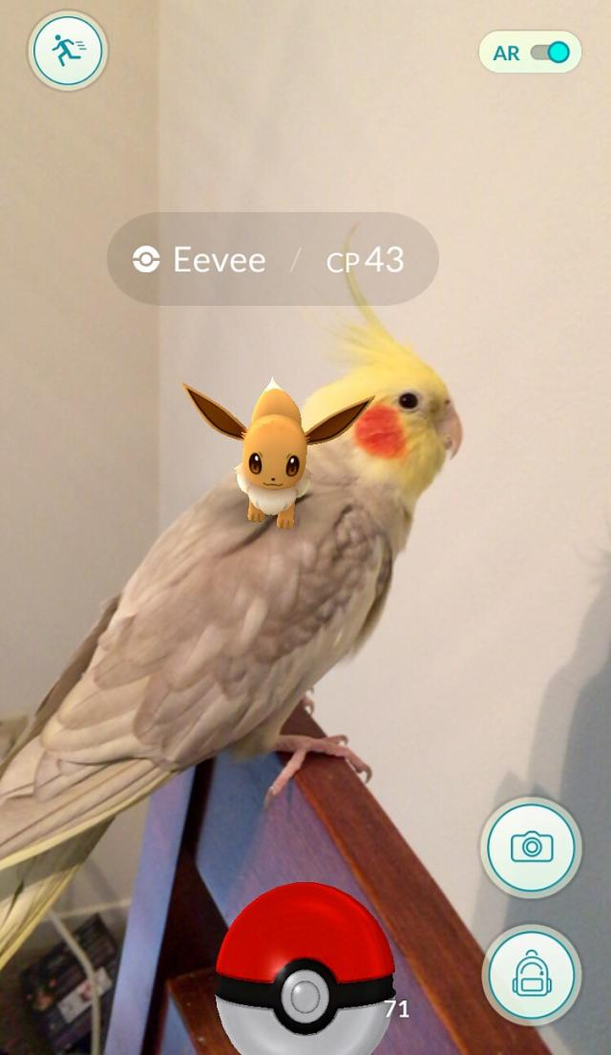
Eevee is ...
the parrot’s back.
ON

Slide 11
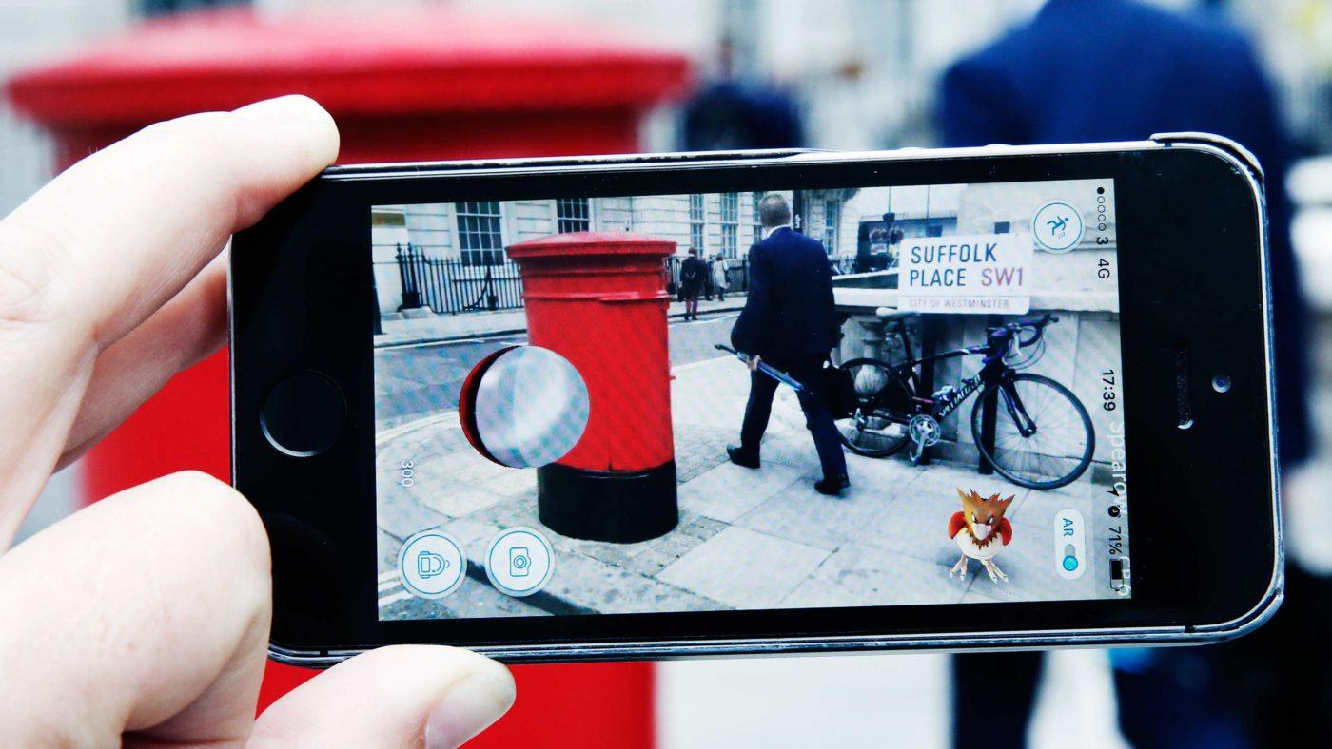
Spearow is ... the bike.
IN FRONT OF

Slide 12
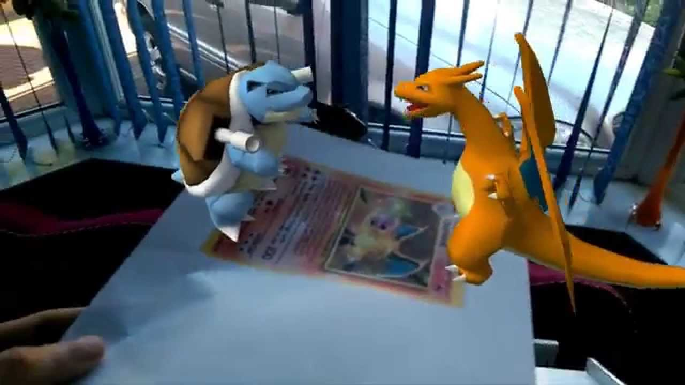
Charizard and Blastoise are
... each other.
OPPOSITE

Slide 13
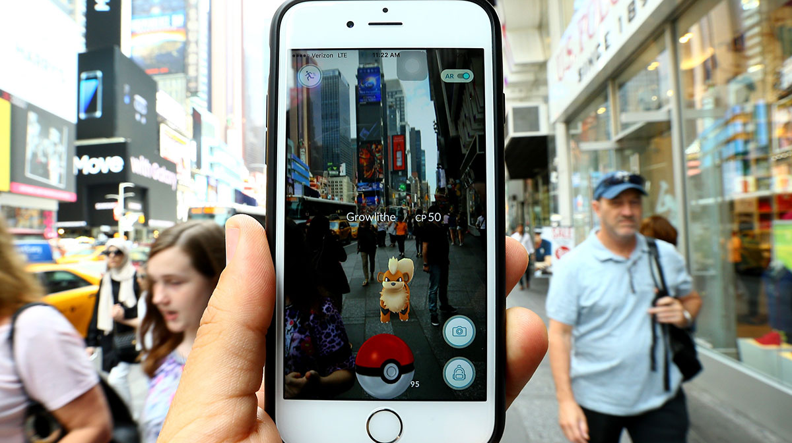
Growlithe is ...
the people.
AMONG

Slide 14
Pikachu is ...
the train.
NEXT TO
NEXT TO = BESIDE

Slide 15
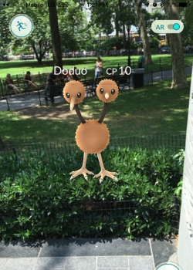
Doduo is ...
the bush.
ON (TOP OF)

Slide 16
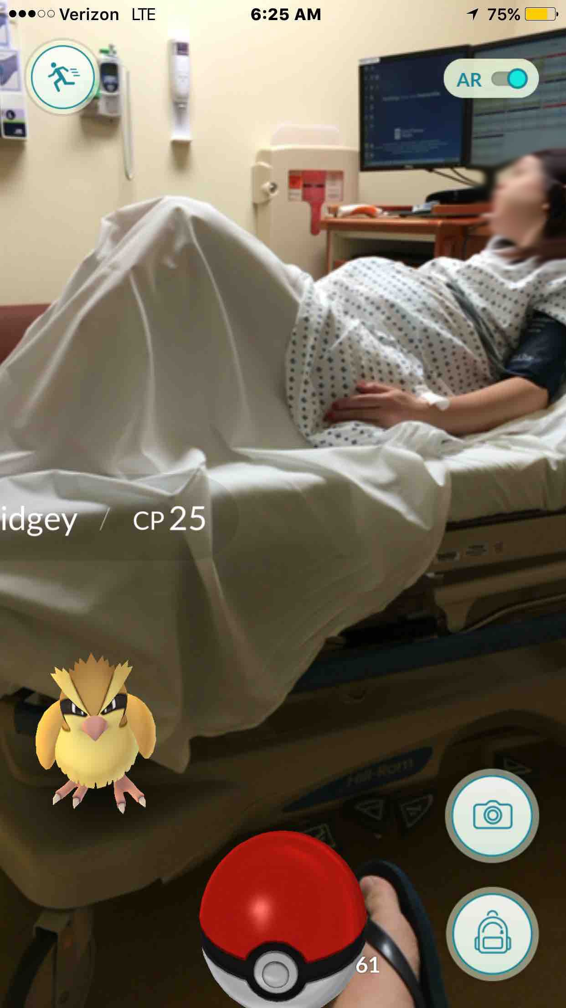
Pidgey is
...
the bed.
IN FRONT OF

Slide 17
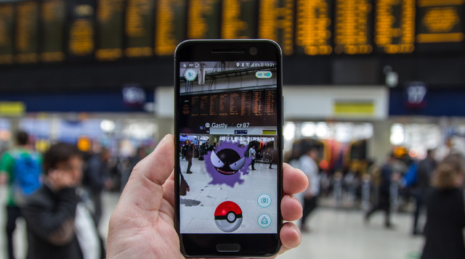
Gastly is ...
the station.
AT

Slide 18
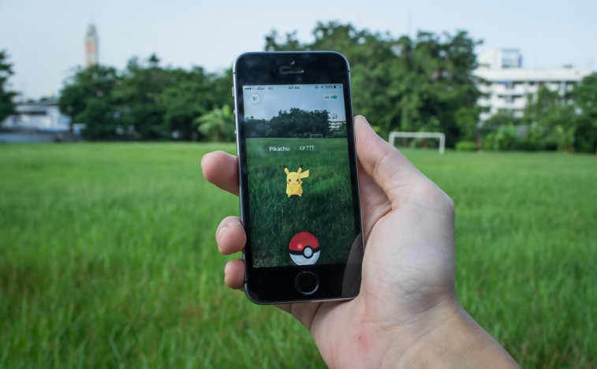
Pikachu
is ...
the field.
ON

Slide 19
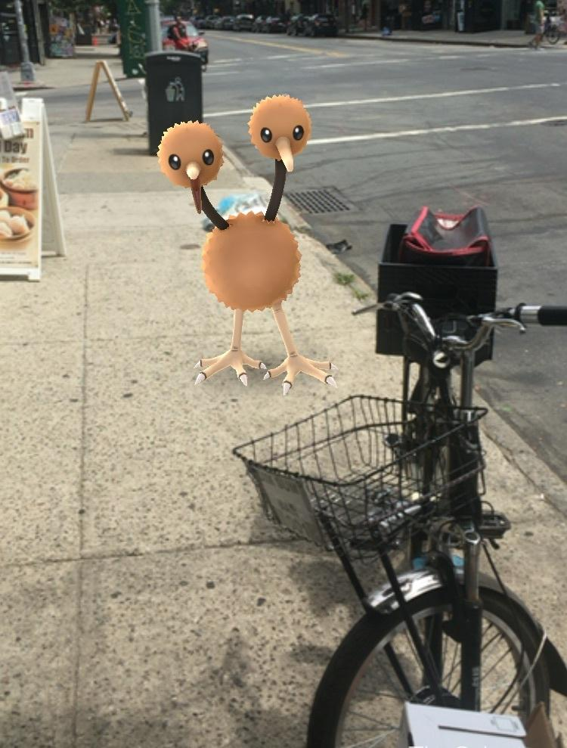
Doduo is ...
the bike.
BEHIND

Slide 20
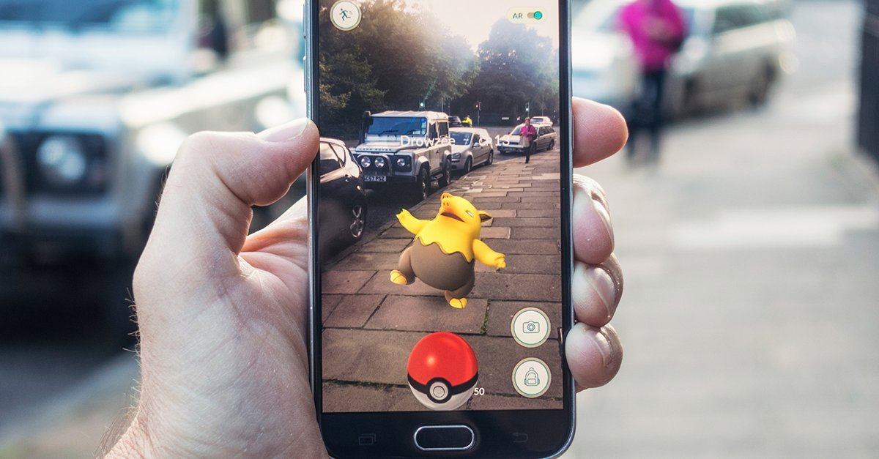
Charizard is ... the sidewalk.
ON

Slide 21
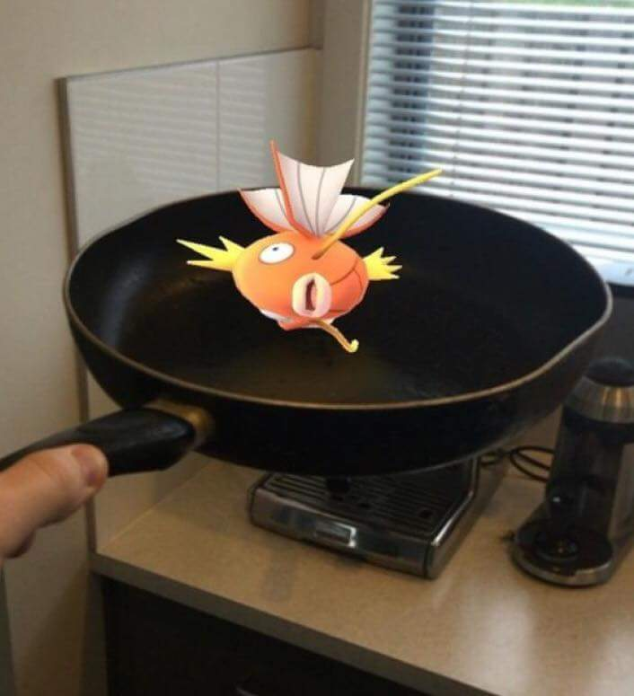
Magikarp
is ... the pan.
IN

Slide 22
Pidgey is
...
the motorbike.
NEXT TO
NEXT TO = BESIDE

Slide 23
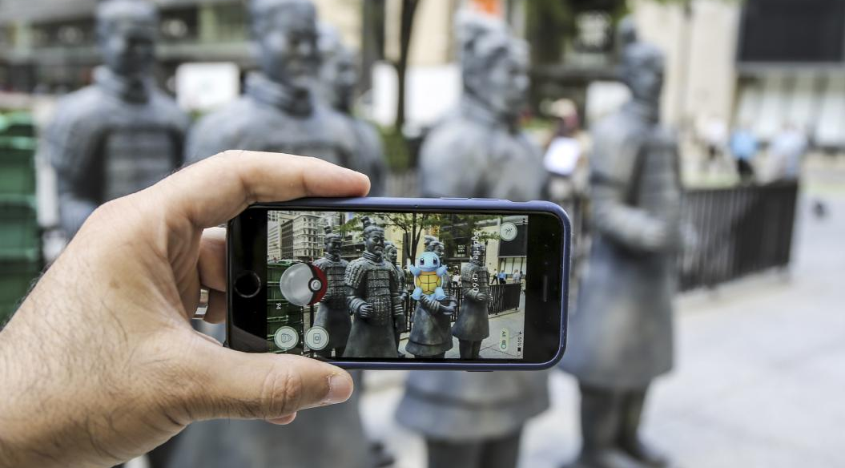
Squirtle is
...
the statues.
IN FRONT OF

Slide 24
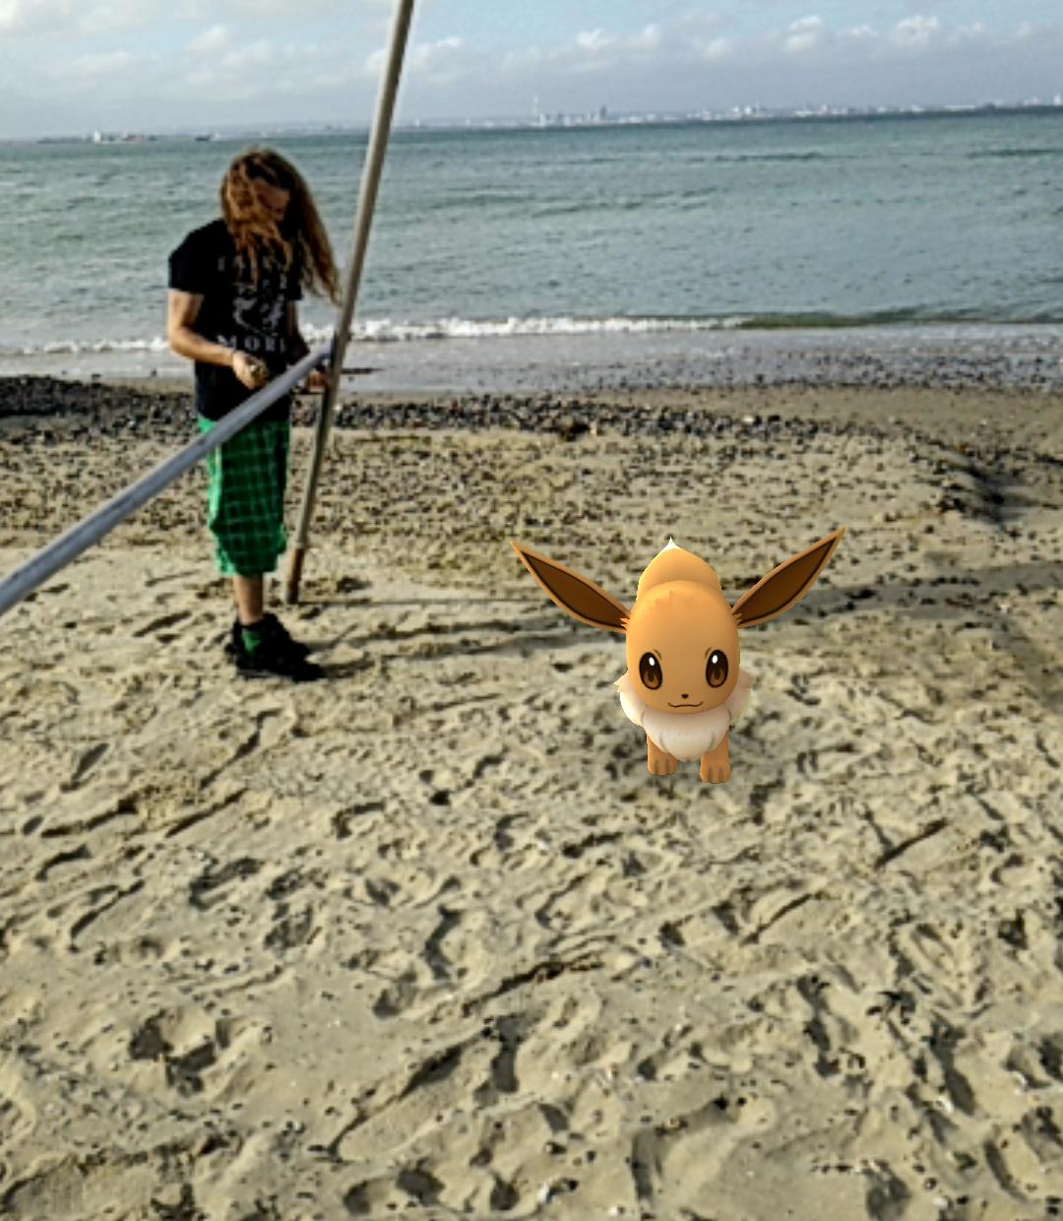
Eevee is …
the beach.
ON

