Slide 1
Integrating Assessment for Learning in the EFL Class Guelmim December 24th, 2016 aberwil@yahoo.fr
By the supervisor Mr. Lahcen Aberwil

Slide 2
Objectives:
Raise teachers’ awareness to the importance of integrating assessment for learning in the English language class
Discover the great learning potential of assessment for learning
Spot salient differences between assessment for learning and assessment of learning
Explore some assessment for learning strategies and techniques

Slide 3
Task: Individually, jot down any words that might come to your mind
about the word ‘assessment’.

Slide 4
Comment on these quotes weighing the sheep does not make it grow

Slide 5
To measure or to learn, that is the question

Slide 6
Defining Assessment for Learning
Task: In pairs, read the definitions and extract the main features of
assessment for learning.
“Assessment for learning is any assessment for which the first priority in its design and practice is to serve the purpose of promoting pupils’ learning. It thus differs from assessment designed primarily to serve the purposes of accountability, or of ranking. An assessment activity can help learning if it provides information to be used as feedback, by teachers and by their pupils in assessing themselves and each other, to modify the teaching and learning activities in which they are engaged. Such assessment becomes “formative assessment” when the evidence is actually used to adapt the teaching work to meet learning needs.”
"Assessment for Learning is a type of assessment that helps students know where they are, where they are going and how best to get there."

Slide 7
Assessment for learning vs Assessment of learning
AFL AOL
* All throughout the course * at the end of a period
(formative) summative
* forward looking * backward looking
* informal * formal
* purpose: improve learning * purpose: check learning
* feedback (teacher,/student) * feedback (teacher)
descriptive grade
* peer /self assessment * teacher-centered
* assessment criteria public * Only the teacher knows

Slide 8
Merits of assessment for learning
It is a tool for improving learning rather than measuring it
Helps learners focus on the aims of their leaning (they understand what constitutes excellence)
Students are more responsible for their learning (they develop skills of learning how to learn)
Students are involved as active partners not subjects
Develops higher order thinking skills
Provides regular opportunities for students and teachers to detect weaknesses

Slide 9
Assessment for learning 5 key strategies
Strategy1:
Sharing learning objectives and success criteria
Why should teachers share these objectives with students?
« If you don’t know where you are going, how will you know
when you get there »
To know:
- where they are
- Where they are going
- How to get there

Slide 10
Strategy 2:
Effective Questioning (good questions cause thinking)
* Ask fewer and relevant questions
* Raise the quality of questions (open-ended questions lead to more thinking and involvement
* Give students time to think (wait/thinking time)
* Avoid shotgun questioning
* Use no hands up except when asking a question
* Encourage student questioning

Slide 11
Strategy 3
Effective feedback (good feedback helps learners move forward in their learning)
Feedback is oral and written
Ensure students know the criteria as they engage in a task
Give quality feedback:
* highlight success
* identify an area for improvement
* give an improvement suggestion
* give students time to proces feedback and act on it
* Avoid unhelpful feedback (too kind, too vague, too critical, too exvessive, too late)

Slide 12
The Four Key Concepts of AFL
Strategy 4
Self assessment
Students should be able to
- understand learning intentions and success criteria
- Use criteria to judge past and future learning
- Act on feedback received from teacher and peers
- Set targets based on what they still need to learn

Slide 13
Strategy 5
Peer assessment
« learners evaluate each other’s work using pre-set guidelines »
What do you think are the advantages of this form of assessment?
What sort of peer assessment activities have you conducted in class?

Slide 14
Assessment for learning activities
TASK:
From the suggested list of activities, which ones have you tried or would like to try with your classes?

Slide 15
The language clinic

Slide 16
No hands up

Slide 17
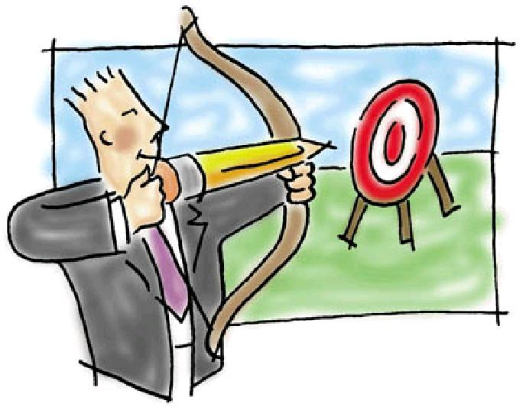
Making aims clear
* Put lesson objectives on
The board at the beginning
Of the session
* Check with students that
they are clear about the
Aims of the whole unit

Slide 18
2 stars and a wish
For peer assessment ask
students to give two stars
And a wish
Two stars: two things
That are good about a
Piece of work
A wish: something they
Can improve to make
It better

Slide 19
Now I can………………….
At the beginning or end of every unit
Provide students with checklists they can
Use for self asessment (tracking progress)

Slide 20
Unit 1 Visa to the World
Now I can ………………….. | Yes | No
Introduce myself and others
Greet people
Talk about myself, family and others
Write a short text following a model
Use the vocabulary for nationalities, family members and physical appearance
Use ‘to be’ in affirmative, negative and interogative forms
Read a short text and look for specific information

Slide 21
Open vs closed
Open questions encourage
Talking and are great at facilitating
The use of abstract thinking skills
Example:
Did you watch a movie on tv last night?
What did you do yesterday evening?

Slide 22
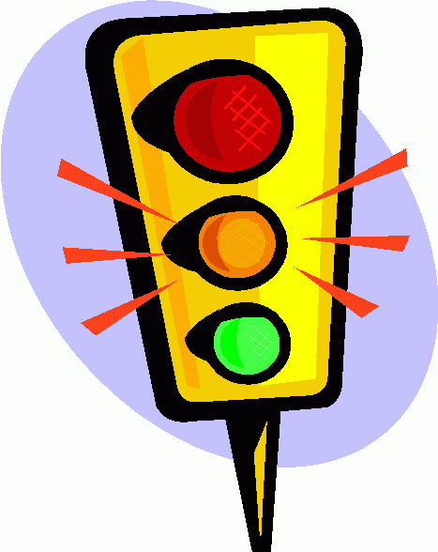
Traffic Lights
Give learners red, yellow and green cards
At different points during the lesson,
ask them to choose a card and put it on
Their desk to show how much they
Understand (red = don’t understand,
yellow = partly understand,
green = totally understand).

Slide 23
Post-its
Use post-it notes to evaluate learning.
Give to groups, pairs or individuals
and ask them to answer questions.
For example:
* What have I learnt?
* What have I found easy?
* What have I found difficult?
* What do I want to know now?

Slide 24
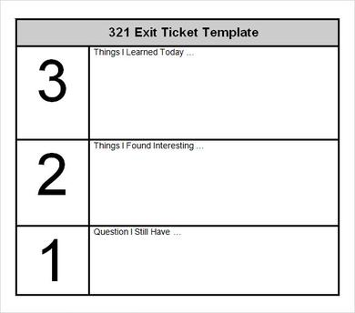
The Exit Ticket
At the end of class, ask students to
respond to a question or prompt:
Write one thing you learned today
- I didn't understand…
- I would like to learn more about…
- Please explain more about…
- I wish…

Slide 25
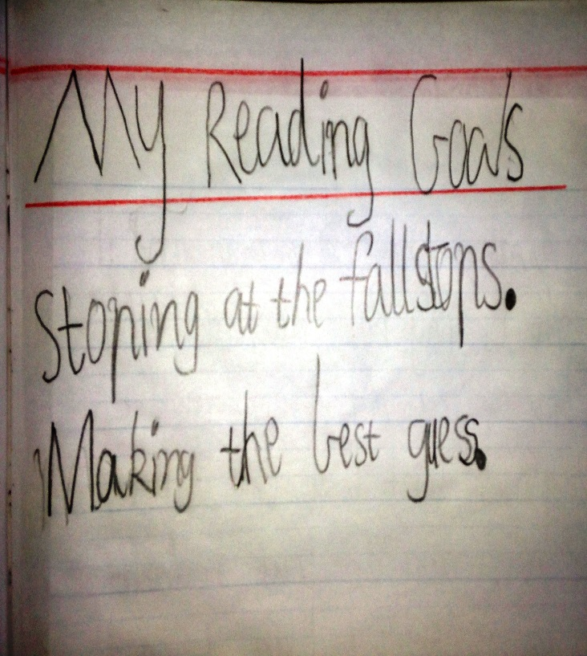
Setting personal goals
After feedback, encourage
Students to set personal goals.
I will learn two irregular
verbs a day
I will read one page story everyday
before I go to bed
I will pay more attention to
punctuation in my writing

Slide 26
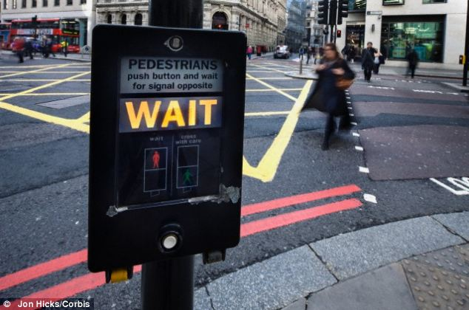
Wait Time
Give 30 seconds silent thinking before any answers.
Ask learners to brainstorm in pairs first for 2-3 minutes.
Ask learners to write some notes before answering.
Ask learners to discuss with a partner before answering.
Use think, pair, share.

Slide 27
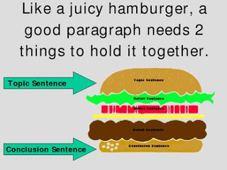
Exemplar Work
Get students to correct using assessment criteria
not only documents with mistakes but also
exemplar work (what makes it a good piece
of work?)

Slide 28
Two truths and a lie
I like fotball
I am not into action movies
I don’t like shopping
Give other examples based on middle school and high school
textbooks

Slide 29
Carousel brainstorming
Could this activity be used for all language components?

Slide 30
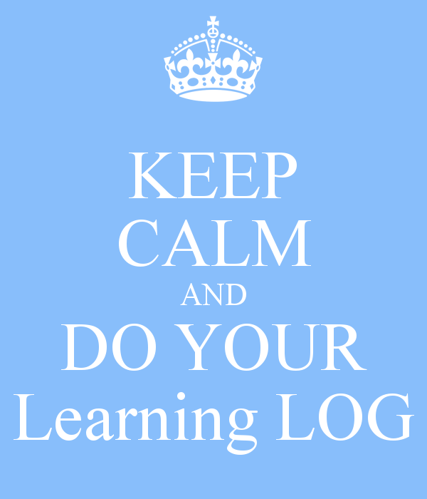
The learning log
get students to create
Learning logs/journals in
which they can reflect on
and review their learning

Slide 31
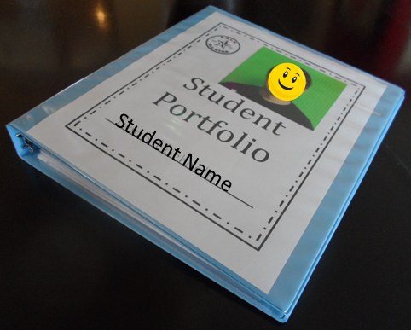
Student portfolios
a file containing samples of students’
Work (homework, quizzes, tests, self assessment
And feedback from peers and teacher). It
Could also include projects, presentations, …

Slide 32
Homework help board

