Slide 1
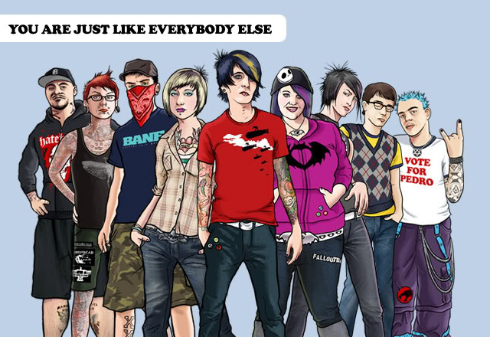

Slide 2

Lead-in Questions.
Why do many people think that communication between teenagers and their parents is often so difficult?
Do you have a good relationship with your parents? Why do you think is that?
What do you think are the most serious problems that teenagers have these days?
Do you think clothes people wear give us information about their character?
Some people are against mainstream culture, seeing it as boring and uninspiring. What’s your view?

Slide 3

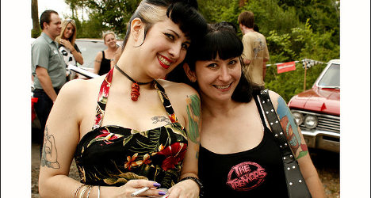
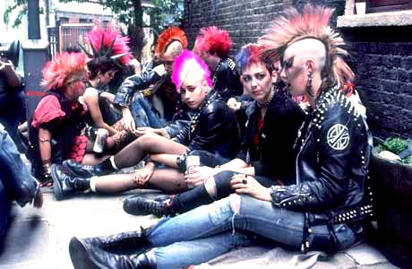
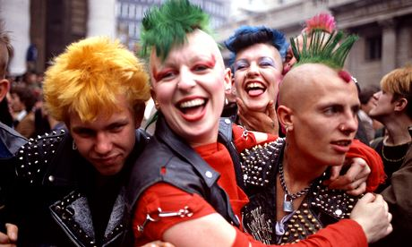
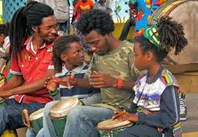
Have you ever heard of urban tribes or youth subcultures? What do you know about them?
Urban tribes or subcultures are made up by relatively small groups of young city people, with a distinct common identity: the same aesthetic codes, the same identity symbols, the same rules, the same language, the same music, the same ideology that are, in general, different from the interests of mainstream culture.

Slide 4
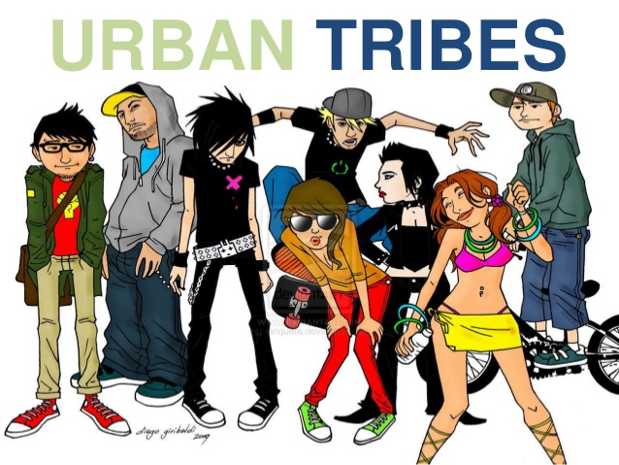
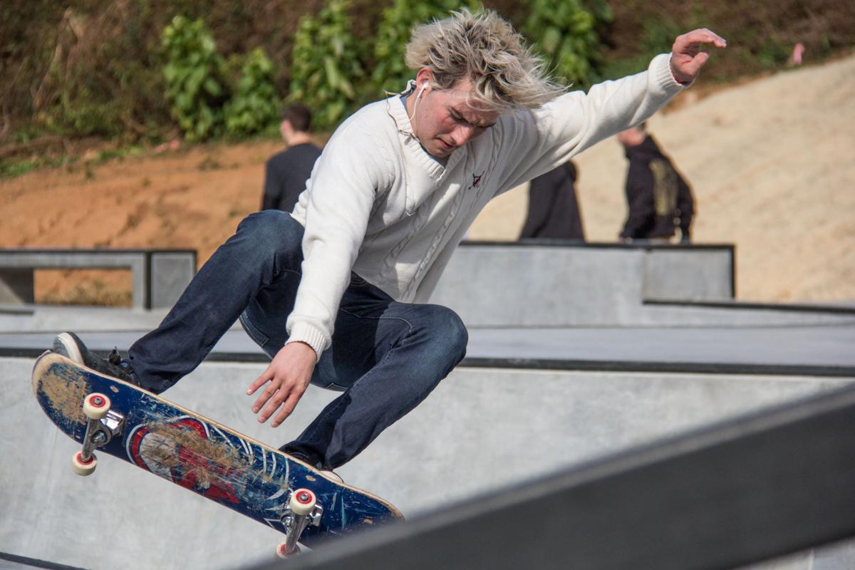
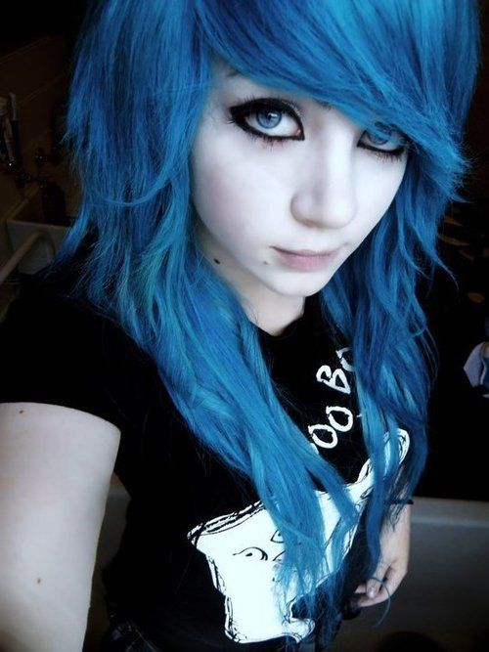

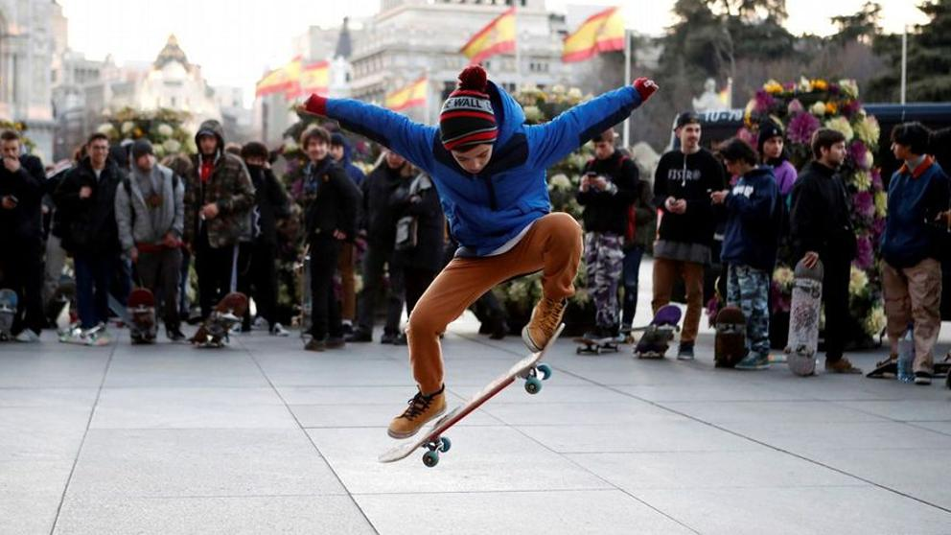
What do you know about these urban tribes?
Skaters
Emos

Slide 5
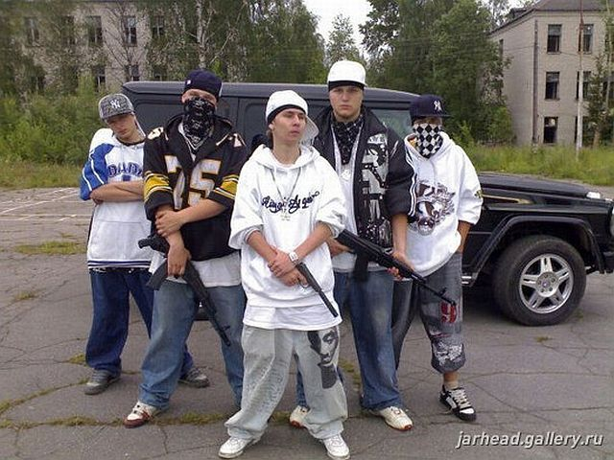
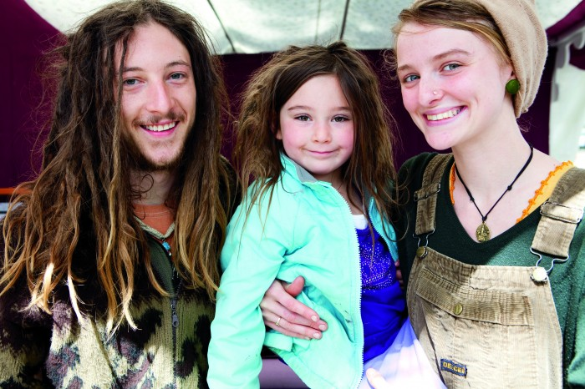
What do you know about these urban tribes?
Hip-hoppers
Hippies

Slide 6
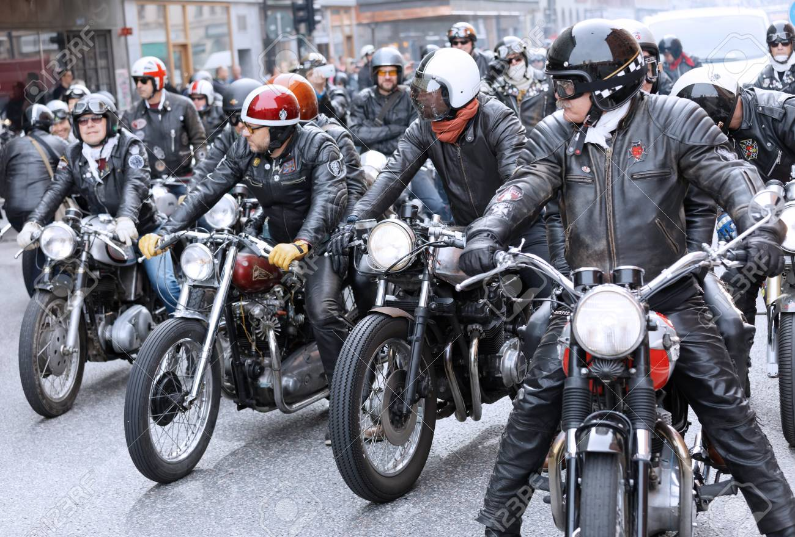
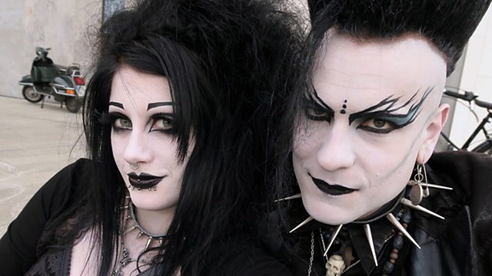
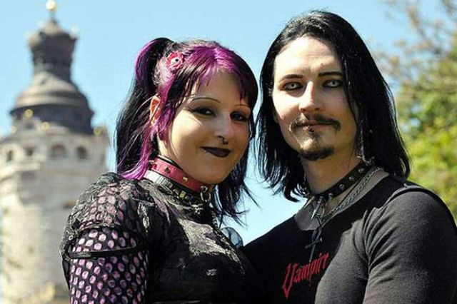
What do you know about these urban tribes?
Goths
Rockers
Rockers

Slide 7
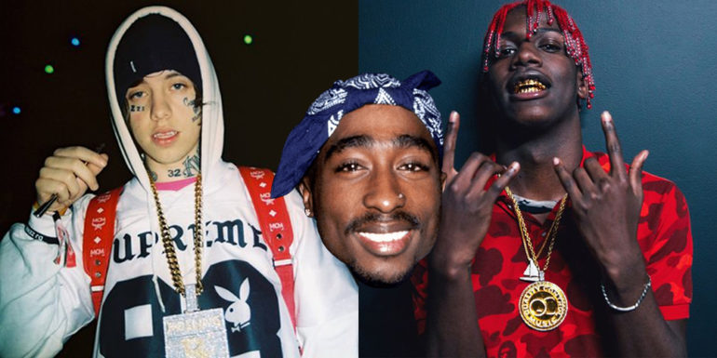

What do you know about these urban tribes?
Pokémons
Rappers

Slide 8
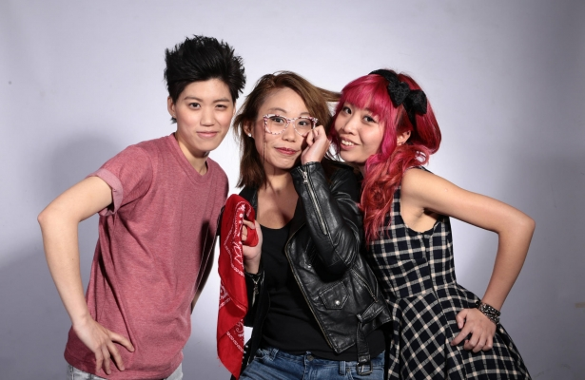
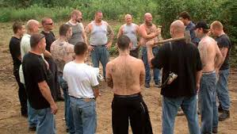
What do you know about these urban tribes?
Skinheads
Indies

Slide 9
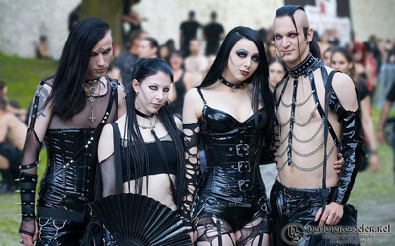
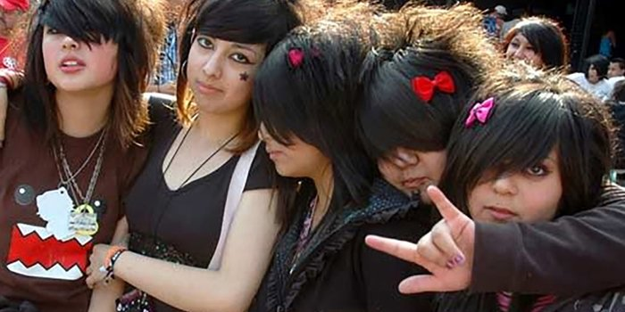
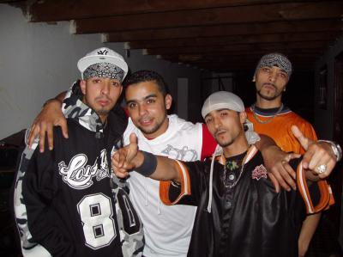
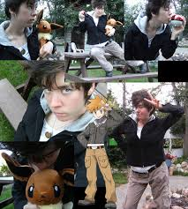
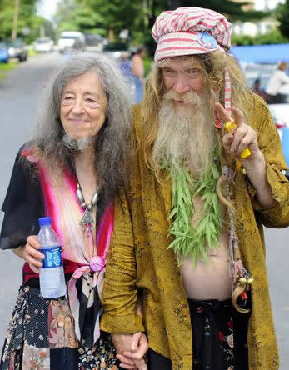
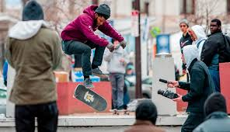
Check your knwoledge
Name these urban tribes.
Hip-hoppers
Goths
Emos
Skaters
Pokémons
Hippies

Slide 10
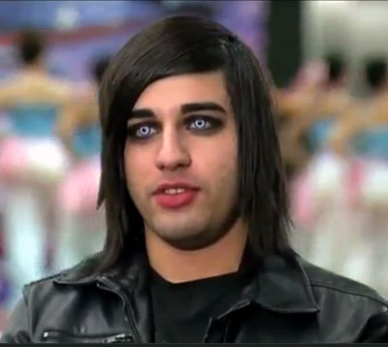
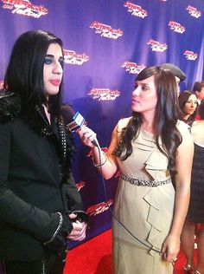
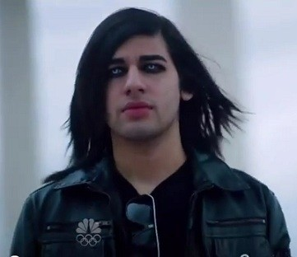
Video Watching
https://www.youtube.com/watch?v=f_3jsyDW76E
Watch the video of “Andrew De Leon” in “America’s Got Talent” and answer the questions.
How did Andrew describe his participation
in America’s Got Talent?
2. How did Howard describe Andrew’s look?
3. Which urban tribe does Andrew belong to?
4. How did the audience react to Andrew’s performance? How did this make him feel?
5. What were the things that astonished the judges about Andrew De Leon?

Slide 11
Video Watching
https://www.youtube.com/watch?v=f_3jsyDW76E
Watch the video of “Andrew De Leon” in “America’s Got Talent” and answer the questions.
They’re a real escape for somebody like him as he felt he’s an outsider.
How did Andrew describe his participation
in America’s Got Talent?
2. How did Howard describe Andrew’s look?
3. Which urban tribe does Andrew belong to?
4. How did the audience react to Andrew’s performance? How did this make him feel?
5. What were the things that astonished the judges about Andrew De Leon?
an unusual look.
Goths
They liked it very much and that astonished him due to the negative thoughts he had about himself.
He’s self-taught and he had never sung in front of anybody.

Slide 12
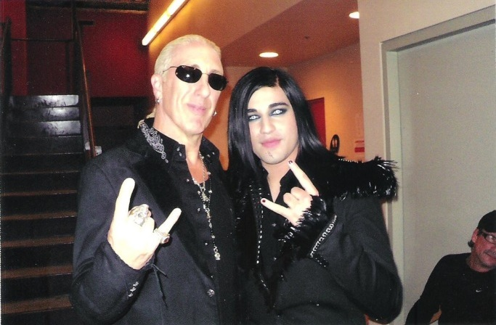
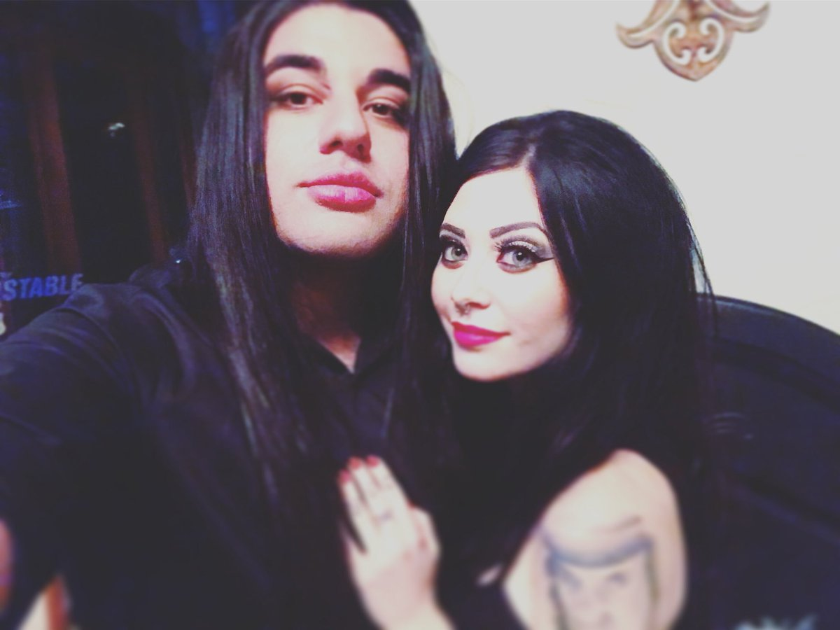
Discussion:
Don’t you think that Andrew is a victim of society’s prejudice and alienation?
Do you know anybody who’s an outcast just because of his/her subculture or look? Tell us about that person.

Slide 13


Slide 14
Vocabulary: Idiomatic Expressions
Idiom | Meaning
(something) in the bag | you are certain to get it or to achieve it.
let the cat out of the bag. | to allow a secrete to be known.
a dead loss | a person who is not successful or useful.
(to do something ) with flying colours. | to do it very easily.
a piece of cake | something that is easy to do.
go cold turkey | the suffering that comes after a person has stopped taking a drug on which they depend.
slip through (somebody’s) fingers. | if something such as a chance, opportunity, or prize slips through your fingers, you fail to get it or to take advantage of it.

