Slide 1
Phrasal Verbs

Slide 2
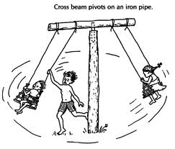
Turn around

Slide 3
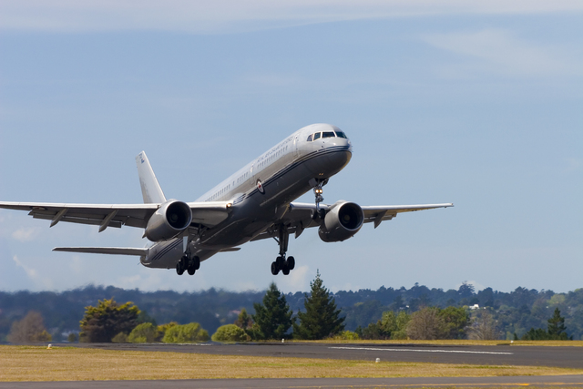
Take off
Hey! Don’t take off your clothes in here!
Fasten your seatbelts, the plane is taking off in a minute.

Slide 4
Put out
Put out your cigarette for your own good!

Slide 5
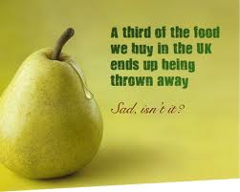
Throw away
I’m throwing my money away!
What are people in the U.K. doing with a third of the food they buy?

Slide 6
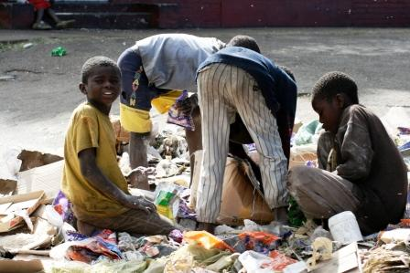
Look for
We’re looking for some food because we’re hungry!

Slide 7
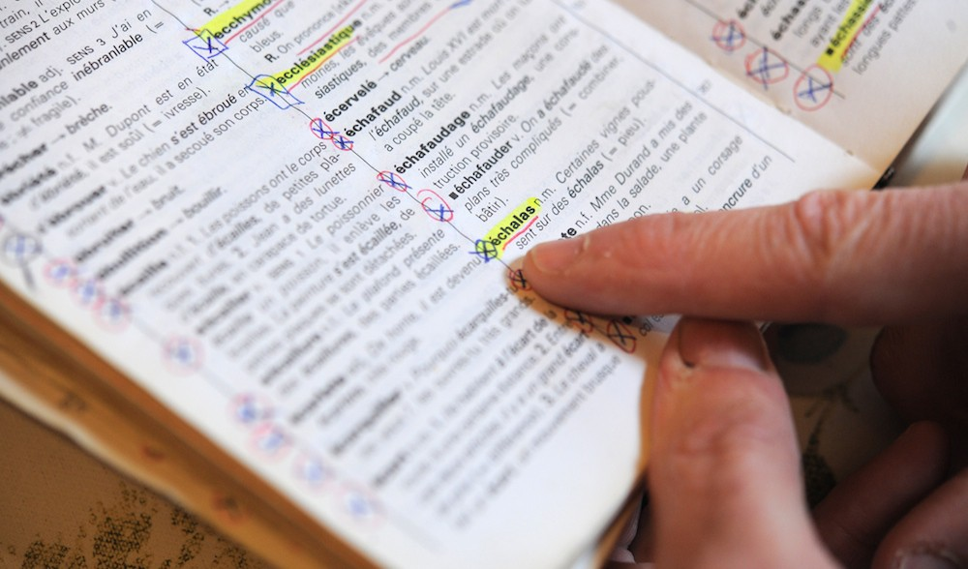
Look up
Look up difficult words in the dictionary.

Slide 8
Make up
Ponicchio is a big fat liar. He always makes up stories.

Slide 9
Try on
When you are buying for clothes or shoes, it’s a good idea to try them on to check if they fit you.

Slide 10
Break down
My car broke down on my way to work.

Slide 11
Break into
Yesterday, a thief broke into our house.

Slide 12
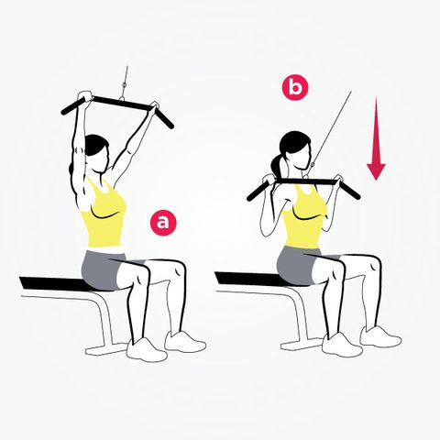
Pull down
She’s pulling down the string!

Slide 13
Set up
AVITO set up a new branch in our neighborhood.

Slide 14
Speak up
Please speak up. I can’t hear you.

Slide 15
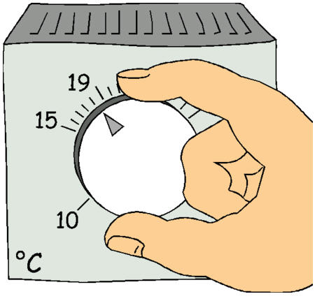
Turn up ≠ turn down
Please turn the volume down.

Slide 16
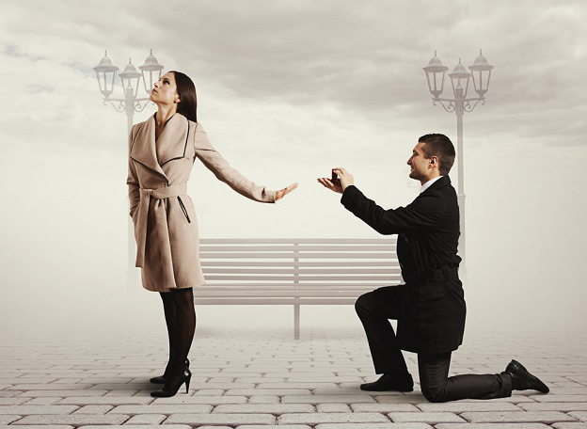
Turn down
He proposed to him, but she turned him down.

Slide 17
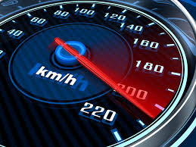
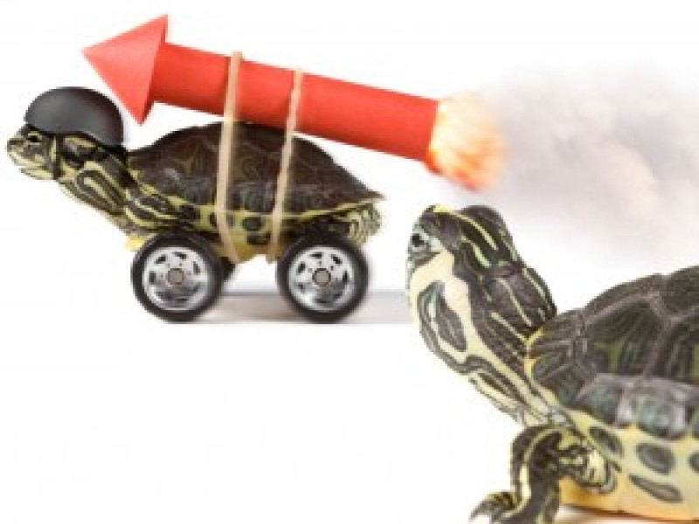
Speed up
Speed up; so you can get before sunset.

Slide 18
Bring up
She was brought up in a lovely home.
She brought up the story of her new phone when we were talking.

Slide 19
Show up
Let’s go! I think Sam won’t show up as he’s too late.

Slide 20
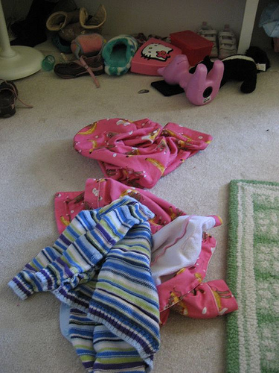
Pick up
Well, your mom will be very angry if you don’t pick up all those things on your bedroom’s floor!

Slide 21
Grow up
What would you like your kids to be when they grow up?

Slide 22
Give up
Have you ever given up doing something?

Slide 23
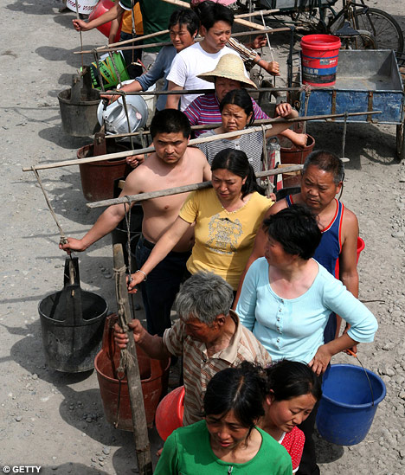
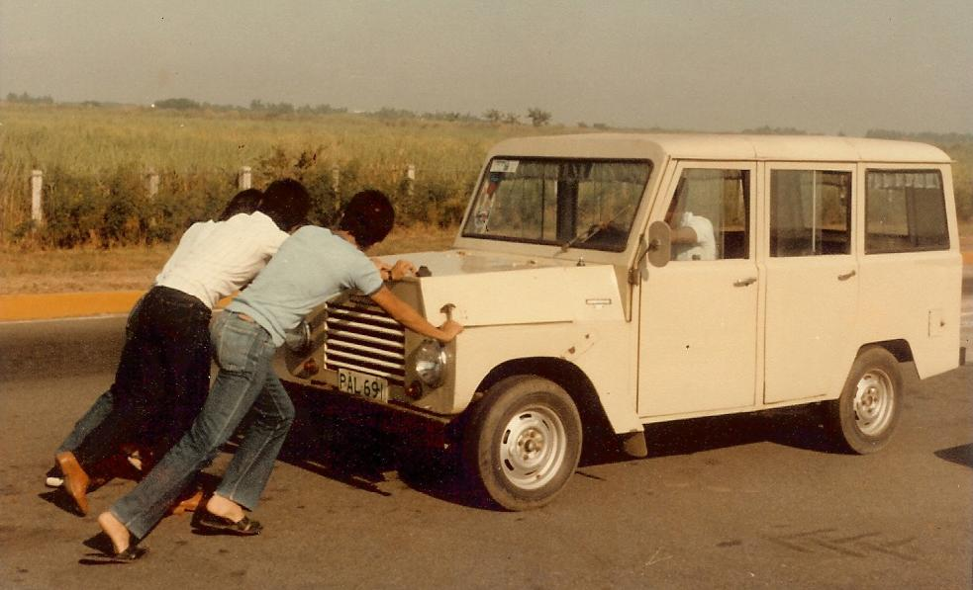
Run out of (something)
These poor people run out of water every week because of the drought!
I can’t believe we ran out of the gas!

Slide 24
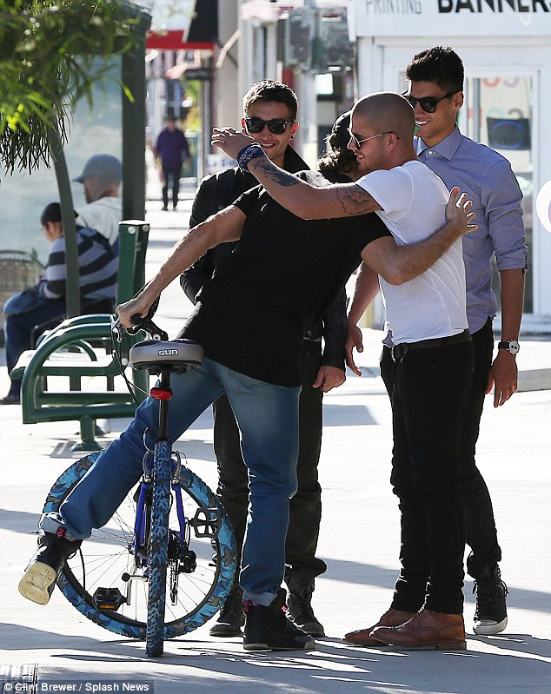
Run into = run across
I ran into/across an old friend of mine while I was riding my bike.

Slide 25
Cheer up
They usually cheer up their boss when they succeed.

Slide 26
Go up ≠ go down
Goods prices usually go up these days.

Slide 27
Make up for (something)
If you forget giving me a hug on my birthday, you’ll have to make up for it!!

Slide 28
Get out Have you ever asked someone to get out of your sight?

