Slide 1
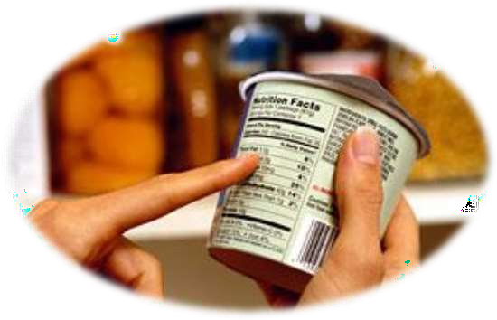
Unit6: Health and Welfare
IMPORTANCE OF READING PRODUCT LABELS

Slide 2









Food
Pesticide
Medicine
Household Products
Personal care
Cleaning

Slide 3

READING FOOD LABEL

Slide 4
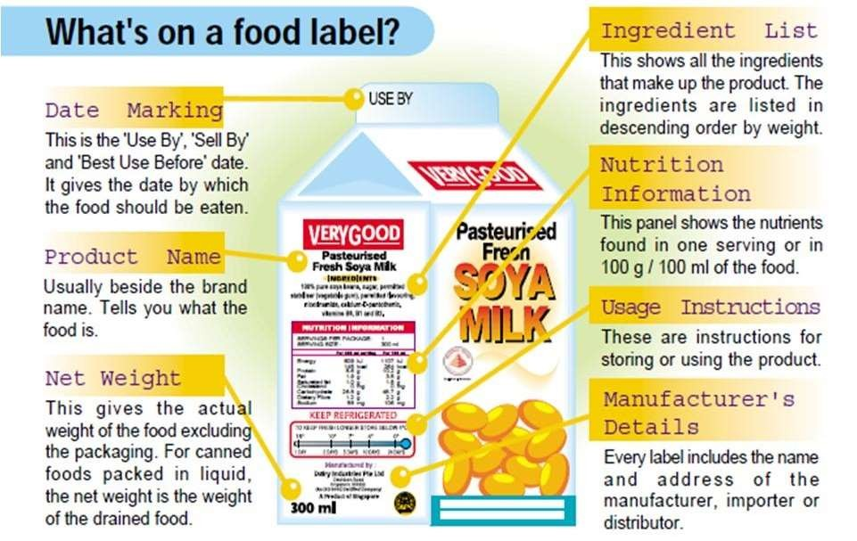

Slide 5
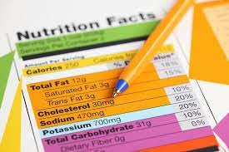

Food labels can help you limit the amount of fat, sugar and cholesterol in your diet by making it easy for you to compare one food item with another and choose the one with lower amount.

Slide 6
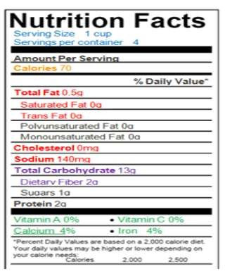
The nutritional information found on a food label is based on one serving of that particular food.

Slide 7
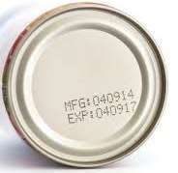
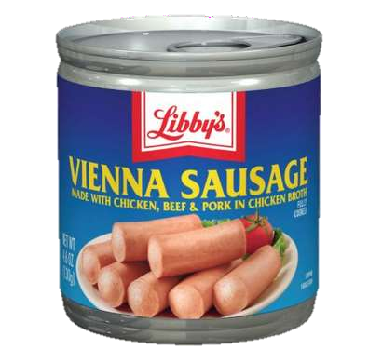
Food label indicate the manufacturing date and expiry date of the product

Slide 8

Study the nutrition facts of a food. List any information you can get from the product label in the data chart below.
Food Serving ^{Ingredients Manufacturing} Best Expiry Date Product Size Before Date Date
1.
2.

Slide 9
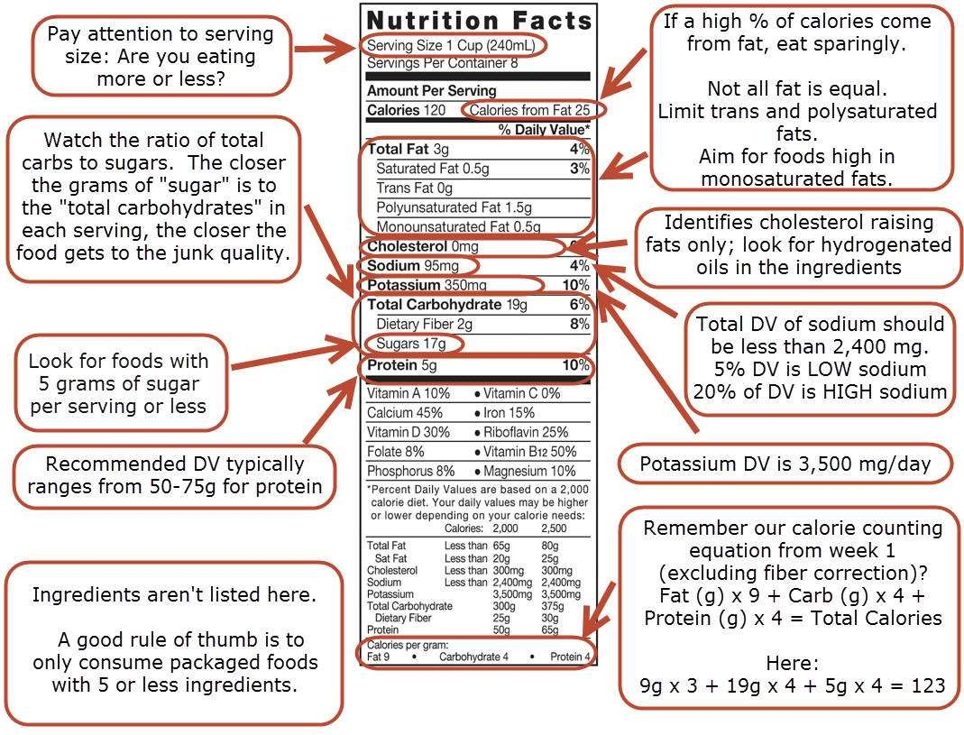

Slide 10







Lower in Sodium
Lower in Sugar
Lower in Saturated Fats Trans Fat Free
Higher in Whole Grain Higher in Calcium

Slide 11
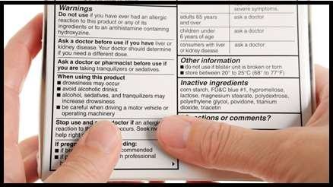
READING MEDICINE LABELS

Slide 12
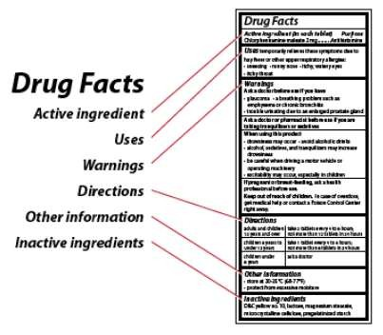
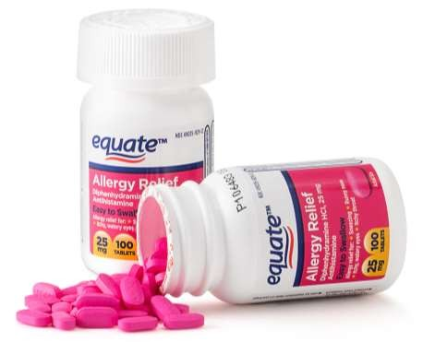
Reading Medicine Labels

Slide 13
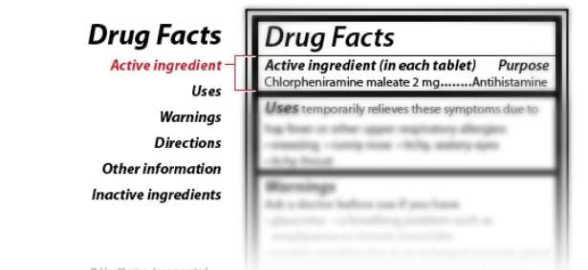
Reading Medicine Labels

Slide 14
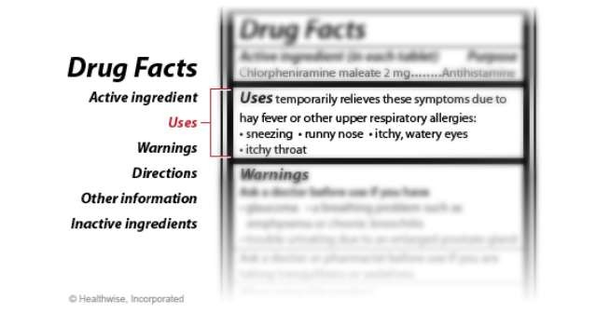
Reading Medicine Labels

Slide 15
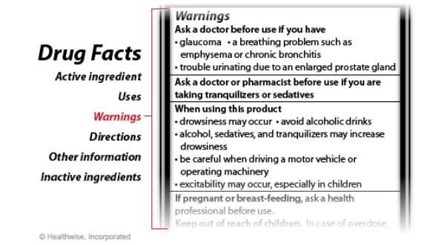
Reading Medicine Labels

Slide 16
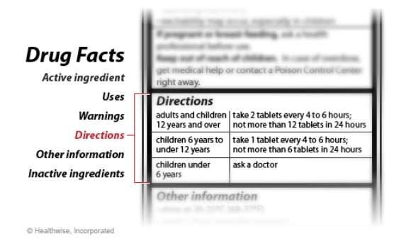
Reading Medicine Labels

Slide 17
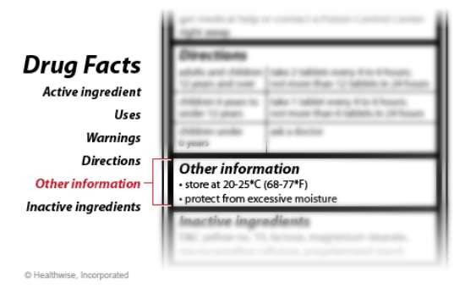
Reading Medicine Labels

Slide 18
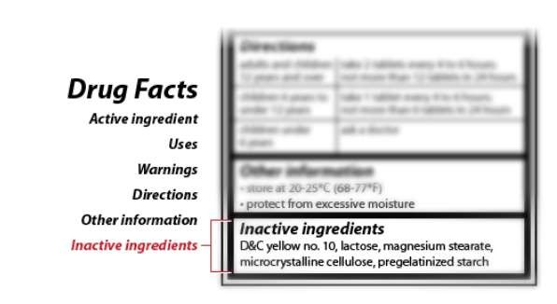
Reading Medicine Labels

Slide 19

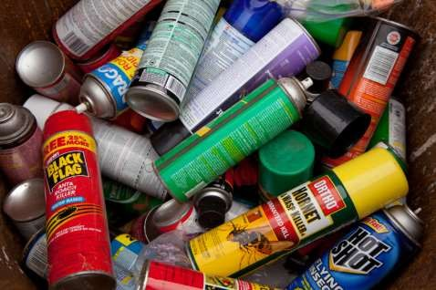
READING PESTICIDE LABELS

Slide 20
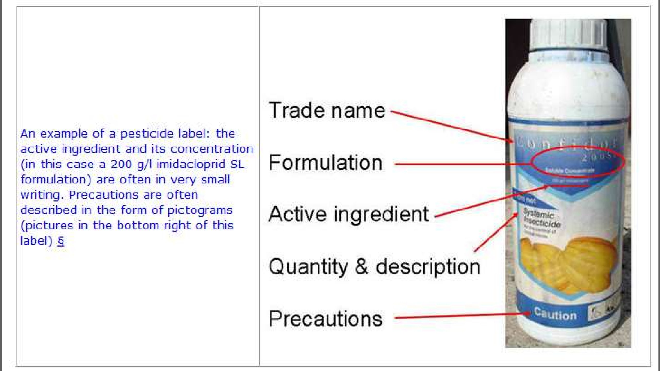

Slide 21
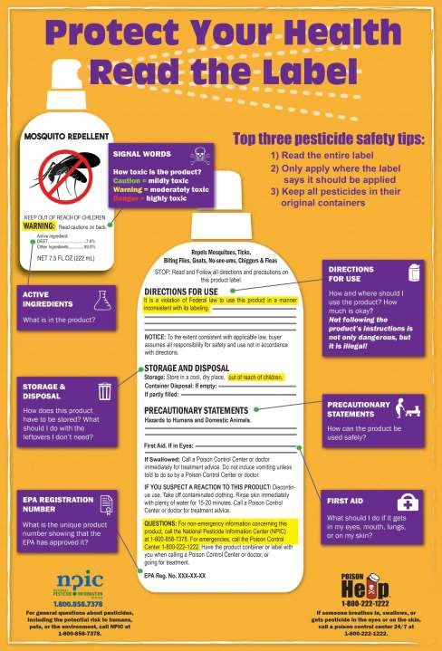

Slide 22
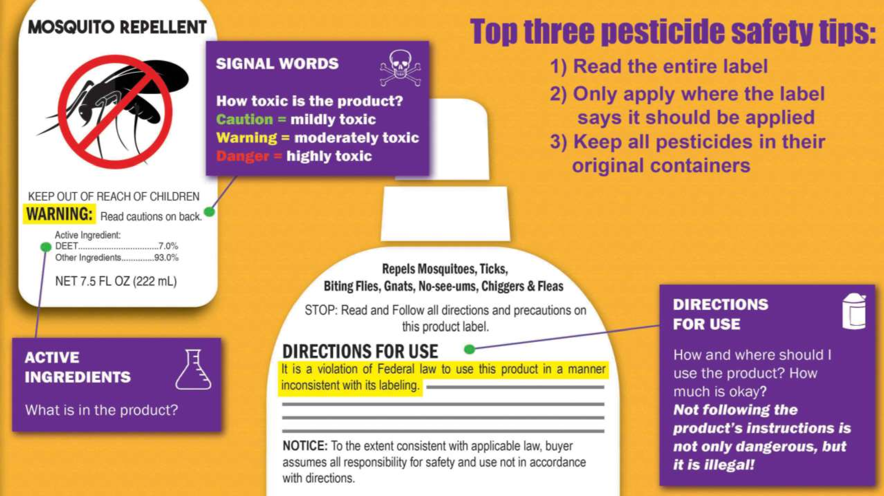

Slide 23
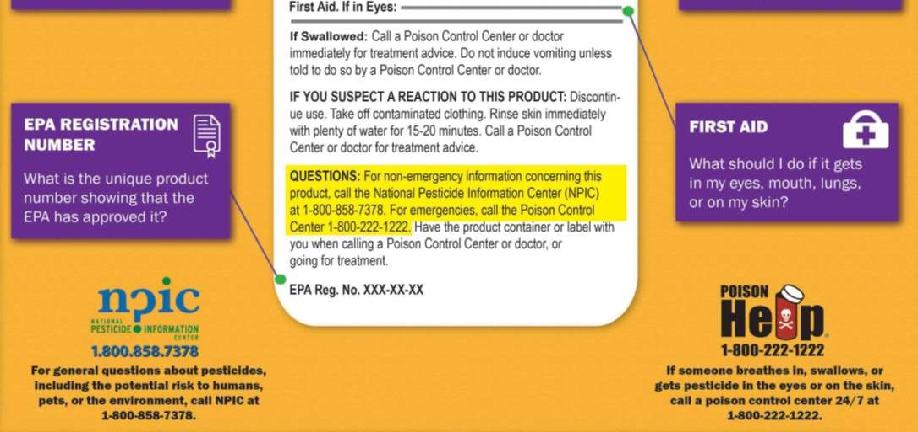

Slide 24


What is the importance of reading product labels?

Slide 25




























They ensure the safety of the user
They give the products ingredients
They warn possible dangers
They describe the proper way of storing the product

Slide 26




Slide 27
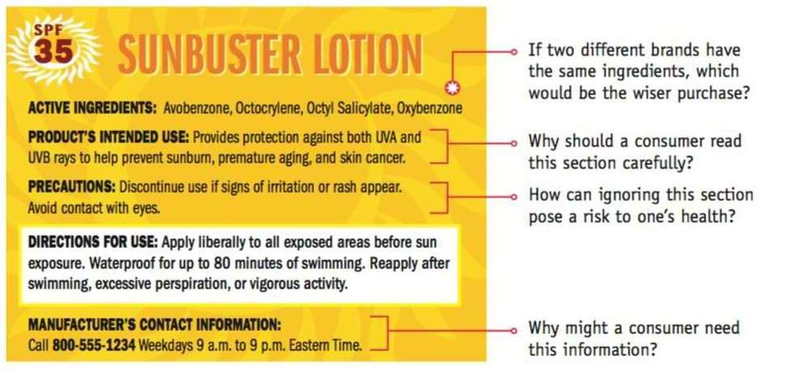

Slide 28
