Slide 1
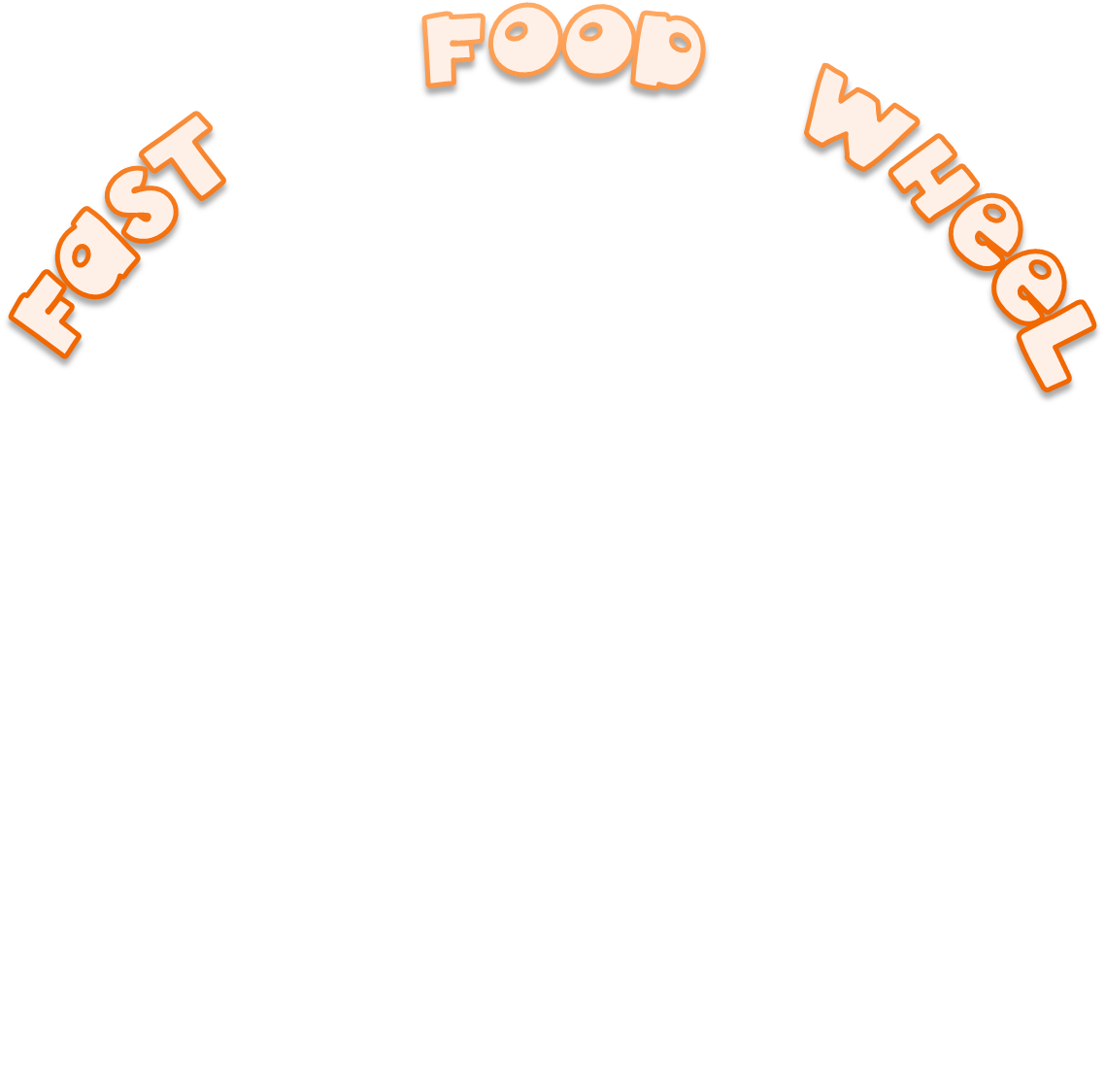







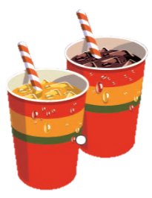









Slide 2



Spin the wheel and click the right word

Slide 3

Spin the wheel and click the right word
hamburger
ice cream
pizza
taco
soda
chips
milkshake
sandwich
hot dog
doughnut
chicken wing
candy bar

Slide 4
Spin the wheel and click the right word
hamburger
ice cream
pizza
taco
soda
chips
milkshake
sandwich
hot dog
doughnut
chicken wing
candy bar

Slide 5
Spin the wheel and click the right word
hamburger
ice cream
pizza
taco
soda
chips
milkshake
sandwich
hot dog
doughnut
chicken wing
candy bar

Slide 6
Spin the wheel and click the right word
hamburger
ice cream
pizza
taco
soda
chips
milkshake
sandwich
hot dog
doughnut
chicken wing
candy bar

Slide 7
Spin the wheel and click the right word
hamburger
ice cream
pizza
taco
soda
chips
milkshake
sandwich
hot dog
doughnut
chicken wing
candy bar

Slide 8
Spin the wheel and click the right word
hamburger
ice cream
pizza
taco
soda
chips
milkshake
sandwich
hot dog
doughnut
chicken wing
candy bar

Slide 9
Spin the wheel and click the right word
hamburger
ice cream
pizza
taco
soda
chips
milkshake
sandwich
hot dog
doughnut
chicken wing
candy bar

Slide 10
Spin the wheel and click the right word
hamburger
ice cream
pizza
taco
soda
chips
milkshake
sandwich
hot dog
doughnut
chicken wing
candy bar

Slide 11
Spin the wheel and click the right word
hamburger
ice cream
pizza
taco
soda
chips
milkshake
sandwich
hot dog
doughnut
chicken wing
candy bar

Slide 12
Spin the wheel and click the right word
hamburger
ice cream
pizza
taco
soda
chips
milkshake
sandwich
hot dog
doughnut
chicken wing
candy bar

Slide 13
Spin the wheel and click the right word
hamburger
ice cream
pizza
taco
soda
chips
milkshake
sandwich
hot dog
doughnut
chicken wing
candy bar

Slide 14
Spin the wheel and click the right word
hamburger
ice cream
pizza
taco
soda
chips
milkshake
sandwich
hot dog
doughnut
chicken wing
candy bar
EXIT

