Slide 2
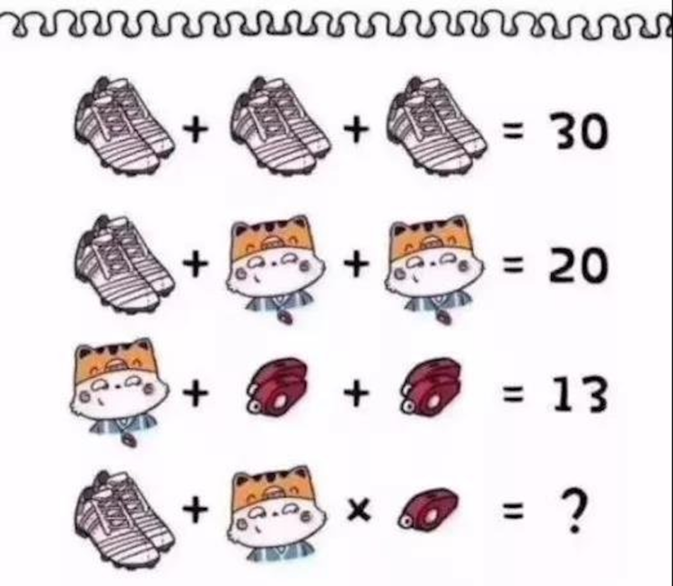
Equation
16

Slide 3
Cause and Effect

Slide 4
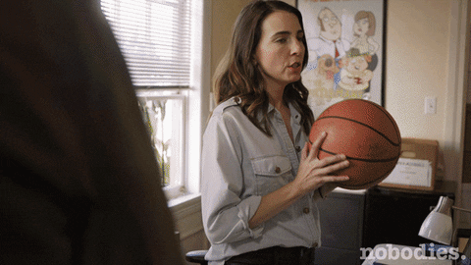
Cause and effect
Johnny insanely threw the ball.
The window broke.
What happened?
Why did it happen?
Which came first chronologically?
Which can we put the conjunction because before?
Which can we put the conjunction so before?
The window broke.
Johnny insanely threw the ball.
Johnny threw the ball
Because Jonny threw the ball, the window broke.
Jonny threw the ball; so the window broke.

Slide 5
A really bad day
Today I am having a really bad day. It started early in the morning. First, when I was having breakfast, my milk spilled on my white shirt uniform. As a result, I had to change my uniform and I was really late to school because of my spill.
Once I got to school, my teacher was really upset as I missed a spelling quiz. I felt really sad since my teacher was angry. Also, my uniform shirt was the wrong color for the day. For this reason, my friends made fun of me at lunch time. I felt really angry at them because they were being really mean. Later, at recess, two boys playing with their ball hit me on my head. Consequently, my head hurt the rest of the day.
What are the signal words that are used to show cause and effect relationship?
Find the causes and the effects in the text.

Slide 6
Choose the correct connectors
It was raining. Since / Because / Thanks to / Consequently I stayed at home.
I stayed at home because of / as a result / because / therefore it was raining.
She remained silent due to / for / for this reason / as a result she was so depressed to talk.
We can't go to Sue's party due to / thanks to / therefore / as we'll be busy working on our project.
The plane was delayed because of / thanks to / for this reason / since the foggy weather.
She had spent most of her time hanging around instead of revising her lessons. As / As a result of / Due to / Therefore, she had a lot of trouble answering the exam questions.

Slide 7
Join the following sentences.
1. Some people believe marijuana should be legal. Marijuana is said to be less toxic than tobacco. (for this reason)
……………………………………………………………………………………………
2. It was raining. I stayed at home. (because of) ……………………………………………………………………………………………
3. Many species of wildlife are becoming extinct. The rainforests are being destroyed. (since)
……………………………………………………………………………………………
4. Logging provides jobs and profits. The government is reluctant to control it. (As)
……………………………………………………………………………………………
5. The weather was cold. Sally put on her coat. (therefore)
……………………………………………………………………………………………

Slide 8
Personal letter
You have recently heard a lot about the phenomenon of brain drain. Write a letter to the editor talking about causes and negative effects of brain drain.

Slide 9
Brain drain: the emigration of highly trained or qualified people from a particular country.
Push factors | Pull factors
• Low wages and income, • Unsatisfactory living conditions‎, • Lack of research and other facilities including ‎support staff, • Declining quality of educational system,‎ • Social unrest, political conflicts and wars,‎ • Discrimination in appointments and promotions, and • Lack of satisfactory working conditions. | • Higher wages and salaries, ‎ • Substantial funds for research, advance ‎technology and modern facilities ‎, • Political stability , • Better working conditions, ‎and • Intellectual freedom ?
Effects of brain drain:
Loss of tax revenue,
Loss of potential future entrepreneurs,
A shortage of important skilled workers,
The exodus may lead to loss of confidence in the economy, which will cause people to desire to leave rather than stay, and
Loss of innovative ideas.

